Slide 1
Supporting Reading in PYP
Tom Barfield, Head of English, Highgate School

Slide 3
“There has also been a huge push on building a reading culture: the library has been reorganised, a librarian employed and classes visit regularly to exchange books and discuss their reading.”
- Ankawa Foundation, October Mock Inspection, 25.10.19

Slide 4
Our reasons for promoting reading
It is the greatest indicator of educational success.
It encourages children to develop empathy, as well as interest in the outside world.
It develops children’s ability to focus.
It develops their language skills.

Slide 6
Recommendations from the October Mock Inspection Report
Develop a KG through to PYP reading scheme that is universal and helps all teachers know where the student’s reading level currently lies.
Reading Corners – good to see them present in every classroom, but they now need to be age appropriate and accessible to ALL students. Consider colour coding from blue (easy) to red (advanced) for the age group.
Reading buddies scheme between KG & PYP years
Phonics Reading Scheme in KG & PYP1.
1:1 reading for each child at least 2 times a week with a member of staff for 10mins. Notes written in Pupil’s Learning Diary but also kept on record to monitor progress of learning by the class teacher in their separate file.
KG would desperately benefit from a functioning and accessible PHONICS programme. We suggested the ‘Jolly Phonics’ programme and the structure of “Letters and Sounds”. The scheme would last the academic year and can be moulded to suit each age group, and support LAs in PYP.
KG would hugely benefit from a structured and recorded Reading Programme. Every child should have 1 or 2 books per week inc. a tin of High Frequency Words, and a Reading “Diary” to log their reading both at home and at School (including written review of reading session from both teachers and parents). The teacher should hear each student read 1:1 for 10mins at least 2 or even 3 times per week. Books should be swapped following the weekly sessions to support the student’s progress. Teachers should also keep a separate file for the whole class to include the level of each student’s book, words they found tricky, if they were fluent or sounding-out any words and progression / problems occurring. This record can then show a clear progression of learning for the student throughout the year and help to transition for KG1 to KG2 and into PYP.

Slide 7
But! There are many challenges…
The lack of a reading culture in Iraq in recent years;
The difficulty of getting books in English;
The challenge of assessing reading ages;
The effects of bilingualism;
The awkwardness some of us feel reading aloud to the children;
The fact that many parents do not read English themselves;
The challenge of mobile devices.

Slide 8
6 Key Factors for Reading Success

Slide 9
1. To read, you must also hear

Slide 10
It might sound odd…
but one of the key ways in which students will develop their reading and continue to enjoy it is through listening to other people read.
This has three main benefits:
It helps with language acquisition;
They can access more challenging works;
It models that adults enjoy books too.

Slide 11
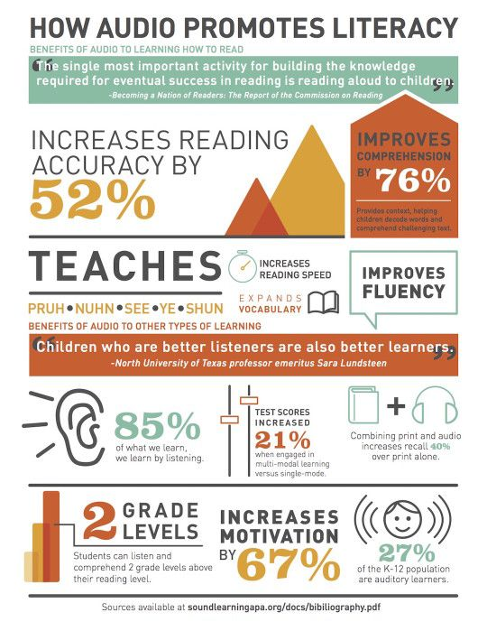

Slide 12
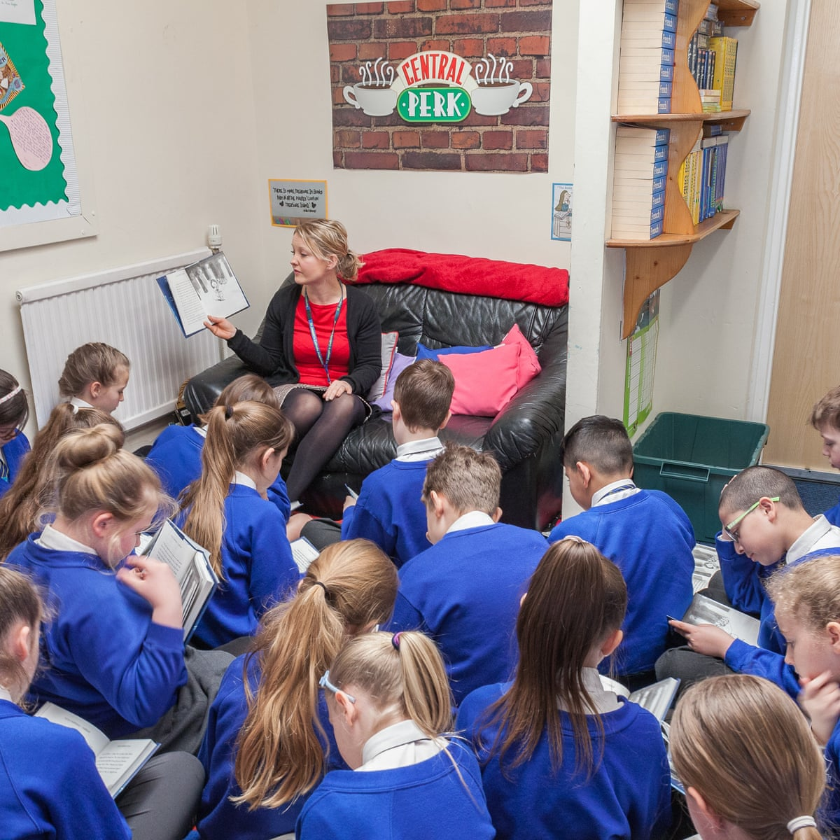
Ways you can help:
Read aloud to the children in the classroom. You can do this all the way up to PYP5. Helen used to do it for her MYP4 class. Do this regularly, at least twice a week.
Encourage the parents to read to their children daily.

Slide 13
But! I am uncomfortable reading aloud for a long time
https://stories.audible.com/start-listen

Slide 14
If you have Word:

Slide 15
Lots of our parents don’t speak English
https://www.booktrust.org.uk/

Slide 16
Get the authors themselves to do it:
https://authorfy.com/

Slide 17
Audiobooks are becoming more popular
Nearly a quarter (23.4%) of children and young people have listened to audiobooks more during lockdown than they did before, saying that they have more time to do so and that they are able to access audiobooks more easily than other book formats.
What's more, listening to audiobooks during lockdown has brought benefits to children's mental wellbeing, with a third (31.8%) saying audiobooks have helped them to feel better.
Audiobooks were also found to provide many children with a route into reading and writing: half (52.9%) of children and young people said that listening to audiobooks got them more interested in reading, while 2 in 5 (42.6%) said that listening to audiobooks made them more interested in writing.

Slide 18
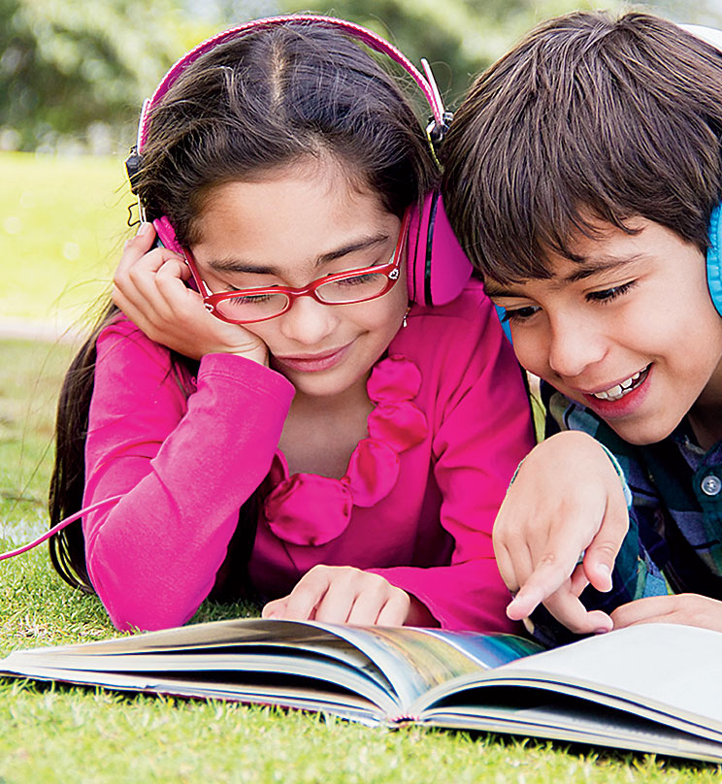
Remember: Reading age lags significantly behind Listening age
Generally, students can listen and comprehend up to two years in advance of the reading age.
The reading and listening ages only even out at around PYP5, and some take longer.
Therefore, when you read to your students, you should challenge them with a more difficult text. This will keep them interested and encourage their desire to read.

Slide 19
2. Teachers must prioritise reading in terms of time and space

Slide 20
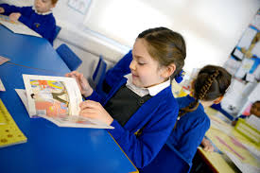
In order to become fluent, students need to read about 600-1000 words a week at the start of PYP
As well as reading to the children, give them time to read themselves.
Vary what they read. Divide the tables up into different types of books and let the children choose which they want (give the first picks as rewards for good behaviour, perhaps!):
Factual reading
Comic reading
Newspapers
Recipes
Stories

Slide 21
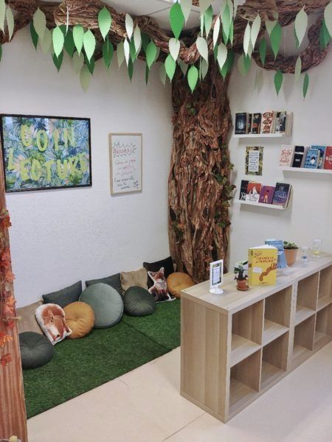
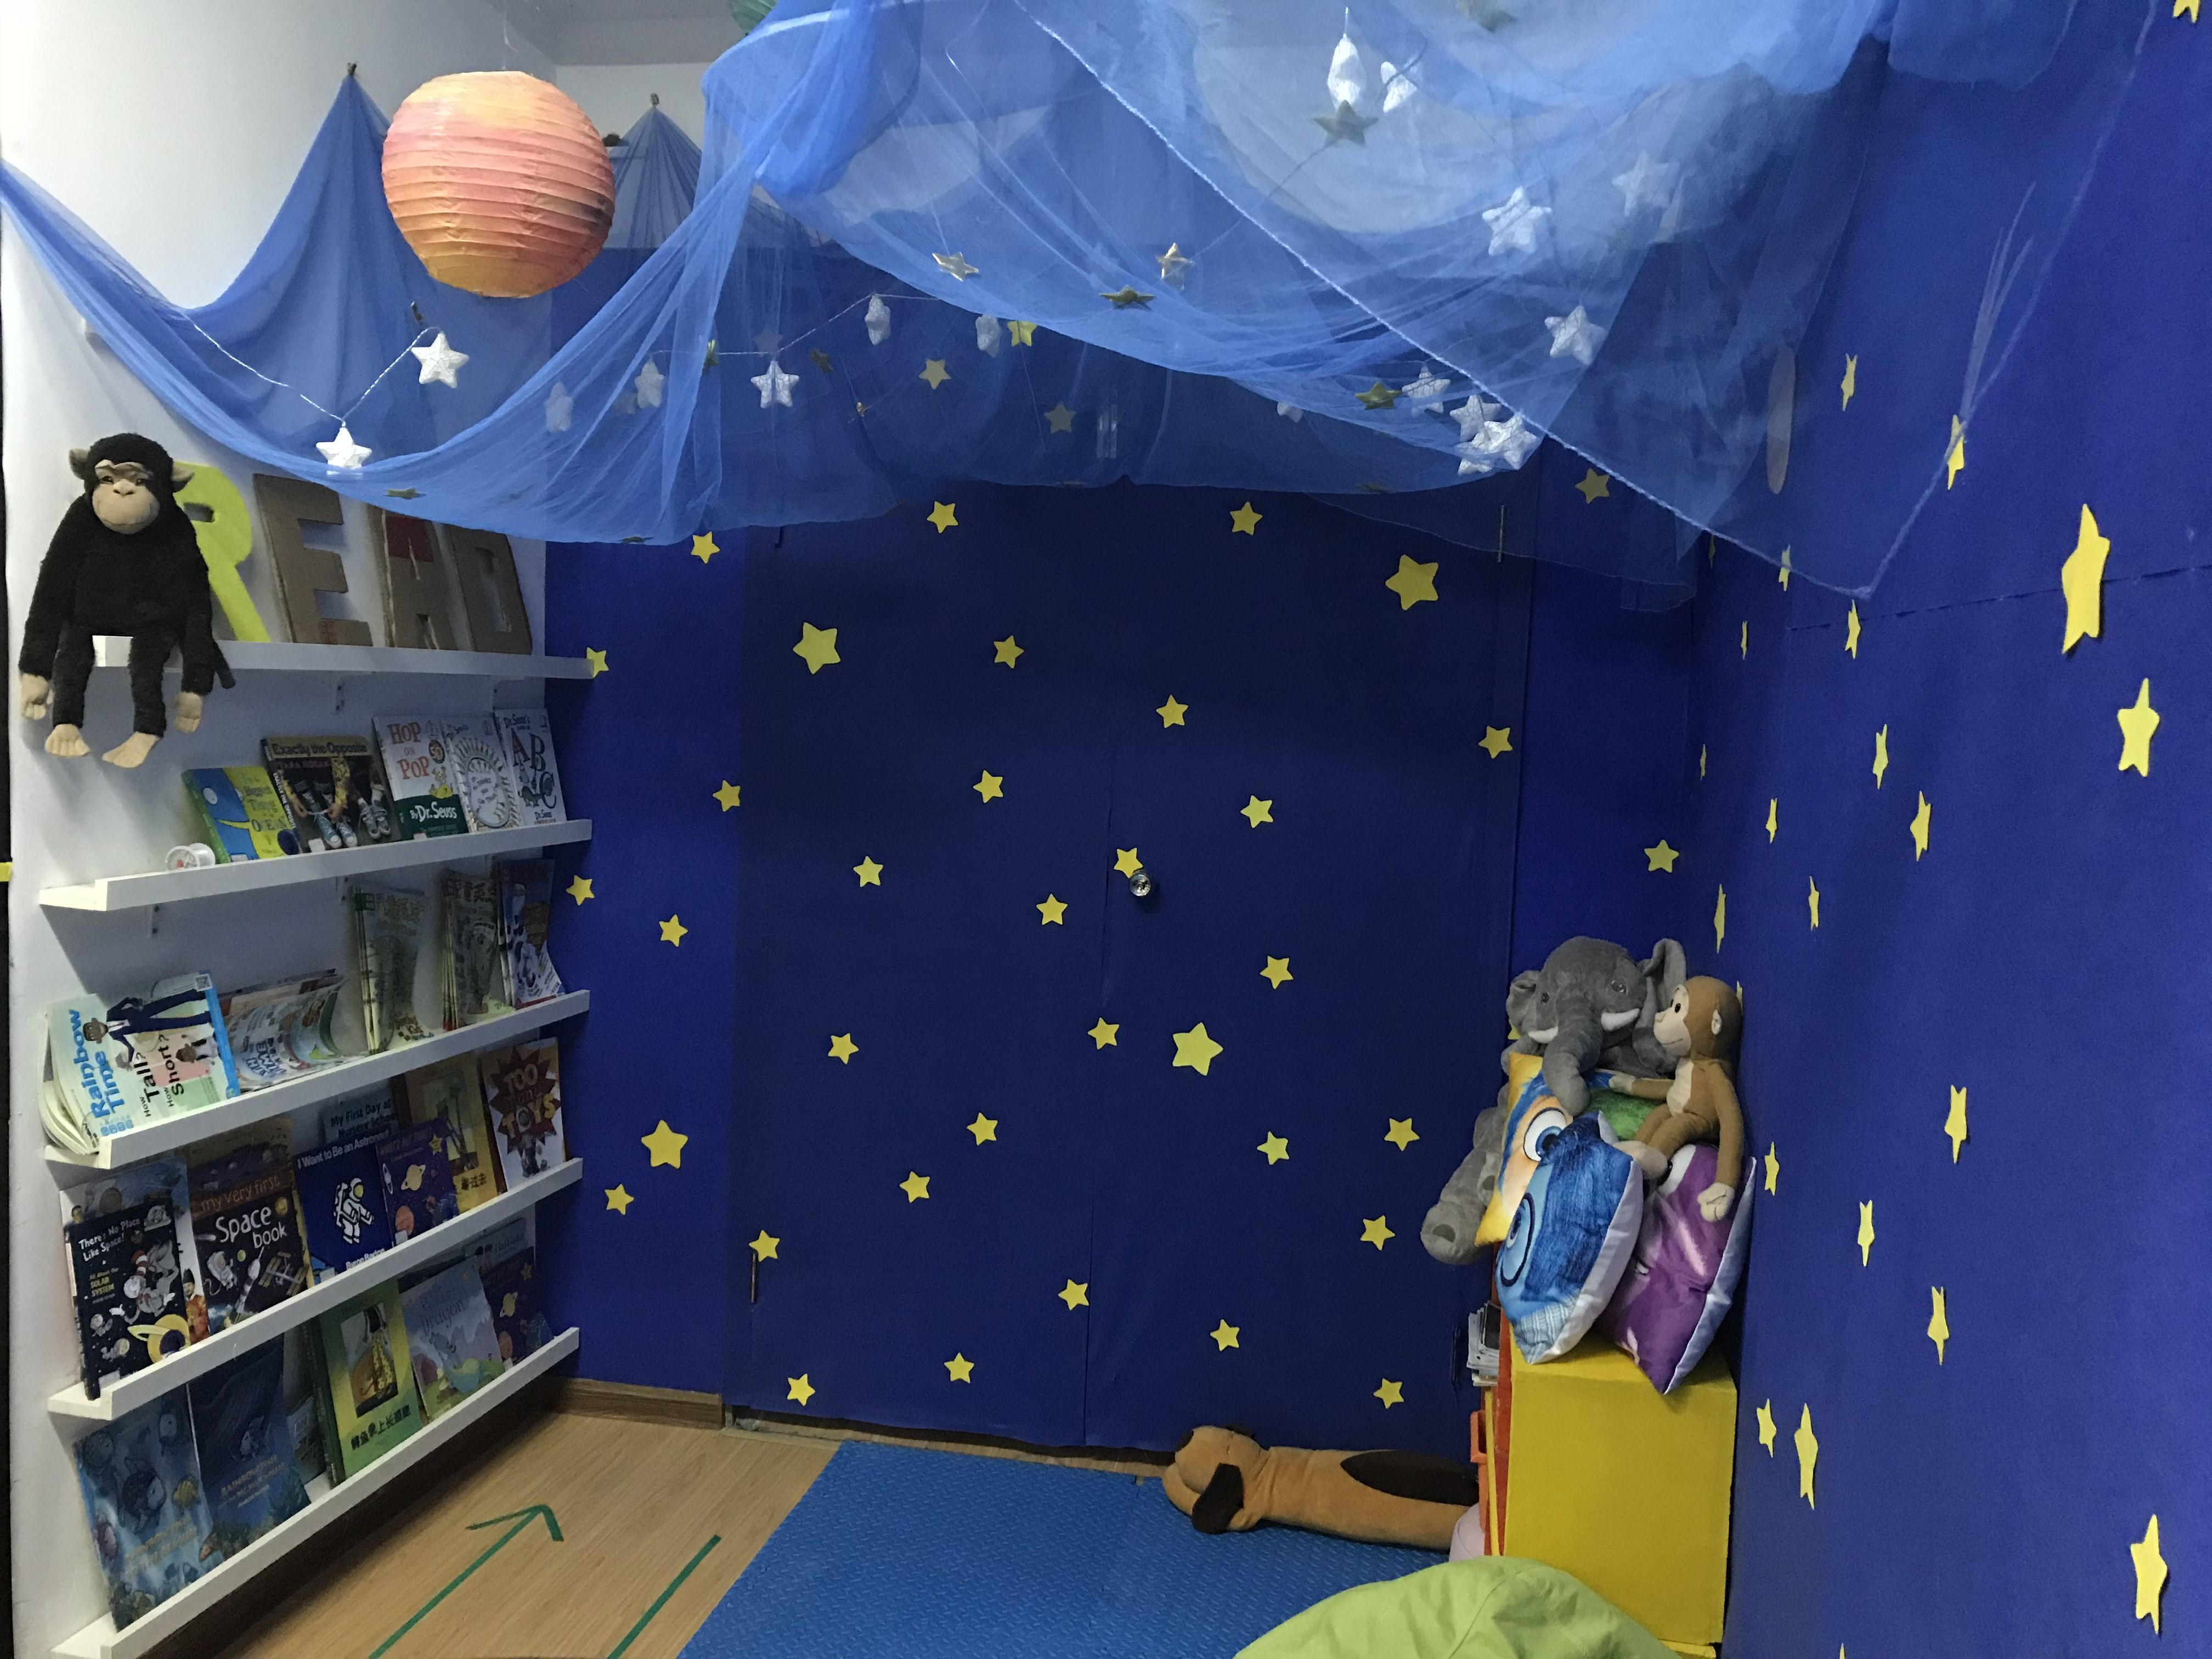
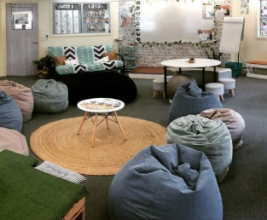
Make sure your reading corner is attractive
Don’t make reading a task or ‘work’, make it a pleasure or reward!

Slide 22
It’s not just books they should be reading
Make sure to label everything in the class!
Display children’s work on the walls
As well as a reading corner, consider a writing corner where students can respond to what they have read
Encourage children to read out what they have written
Have a letter box and class newspaper to read each other’s work
Consider writing a class storybook together

Slide 23
3. Parents should lead by example

Slide 24
Watching your parents read is the most powerful argument for picking up a book
But! There is not as much of a reading culture in Iraq, you say…
Here are a few handy resources that explain the value of reading with your children:
https://cdn.literacytrust.org.uk/media/documents/At_home_booklet_for_parents_final_Kurdish_spreads.pdf
https://literacytrust.org.uk/resources/english-and-arabic-bilingual-quick-tips/

Slide 25
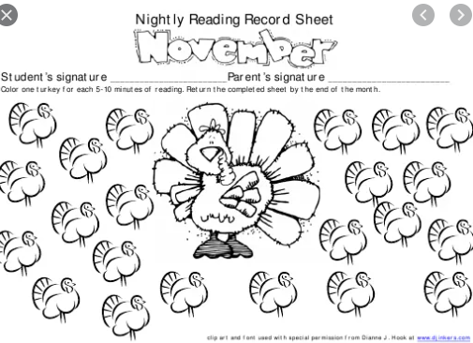
Set clear expectations
Every family should hear the children read to them every day.
They should have a little reading booklet to tick off that they have done this and any comments.
The teacher should monitor this.
If you have a family where no-one can hear the child read in English, then you, the teacher, must make sure that you hear the child read everyday.

Slide 26
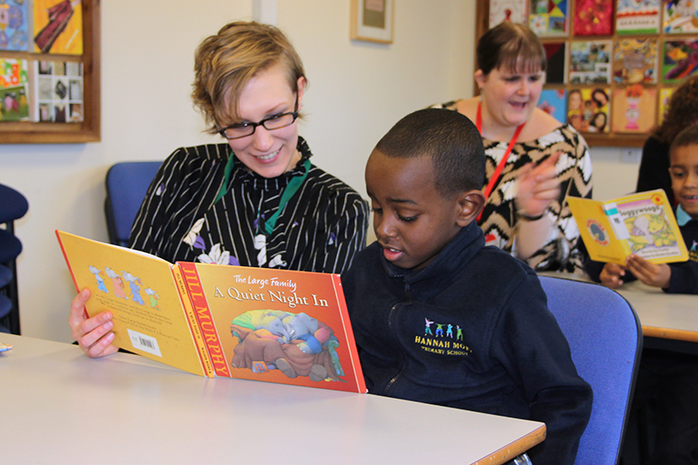
Create a reading culture!
Lead by example:
Start a bookgroup at school where all the staff read a novel then come together to discuss it.
Do the same with the parents!
If you have parents who have good English and are keen to help, have an arrangement where they can come in to the classroom to help hear the children read.

Slide 27
4. You need to find what interests you

Slide 28
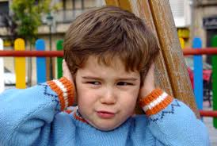
It can be difficult finding books you enjoy
You can start by, as a teacher, encouraging the children to engage with the reading and personalising it to their own experience.
Ask them questions: “Would you have acted this way?” “What would you have said to her at this point?” “What is weird about the way they are acting?”
Consider different types of reading: it does not always need to be a story or novel, although it should be at the right level and always challenging.

Slide 29
There is plenty of help out there
Bookfinder:
https://www.booktrust.org.uk/books-and-reading/bookfinder/
The National Shelf Service (daily recommendations from UK librarians): https://www.youtube.com/channel/UCPUIqlJM0aieXdq-LxKDvWA?app=desktop
Toppsta:
https://toppsta.com/blog/view/bookish-ideas-if-you're-self-isolating-with-the-kids

Slide 30
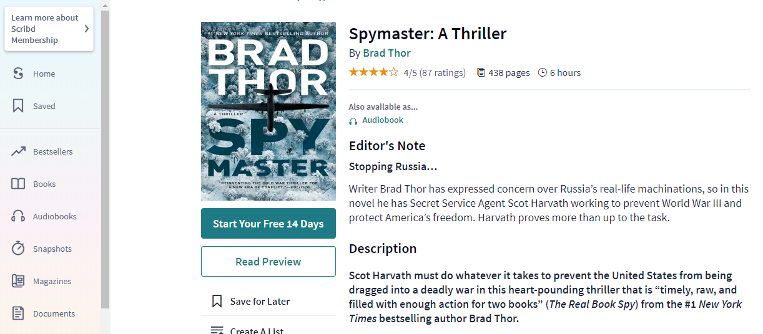
Free books!
Bookstrust
Gutenberg (older books)
Scribd – free 30 day trial

Slide 31
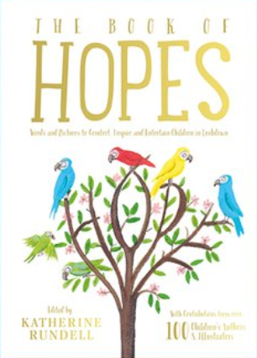
One Example – The Book Of Hopes
https://literacytrust.org.uk/family-zone/9-12/book-hopes/
https://cdn.literacytrust.org.uk/media/documents/Year_6_teaching_sequence_-_The_Book_of_Hopes.pdf

Slide 32
5. You need to be pushed to read at the right level

Slide 33
Children must always be developing their reading
To do this, we need two elements:
You need an accurate idea of what age the student is reading at;
You need a clear programme of increasingly challenging texts: a reading scheme

Slide 34
Identifying a child’s reading age
There are a range of ways of identifying a child’s reading age.
Straightforward reading out loud test:
The Hertfordshire Reading Test
http://www.readingtest.co.uk/burt-test/
When you hear a child read, you will be able to tell whether they are succeeding or struggling with the level of the text. If you already know the level of your texts, you will be able to adjust their book choices accordingly.

Slide 35
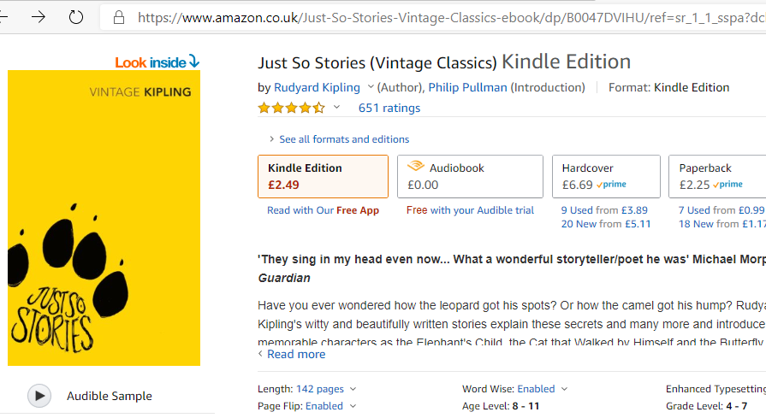
How do identify the reading age of a book?
You can check on Amazon:

Slide 36
More accurate tools
Lexile:
https://hub.lexile.com/find-a-book/search
ATOS:
http://www1.renaissance.com/Products/Accelerated-Reader/ATOS/ATOS-Analyzer-for-Text

Slide 37
Use these tools together to create a clear reading scheme
Books should be colour-coded in terms of difficulty so that, as a teacher, you know which to offer next.
You need to keep a record of what each child is reading, how long they have taken, whether they have struggled.
The reading records should be part of the discussion with parents and next year’s teachers.
A child with a persistently low reading age will need an intervention.
Interventions, extra reading lessons, can RAPIDLY improve a child’s reading age.

Slide 38
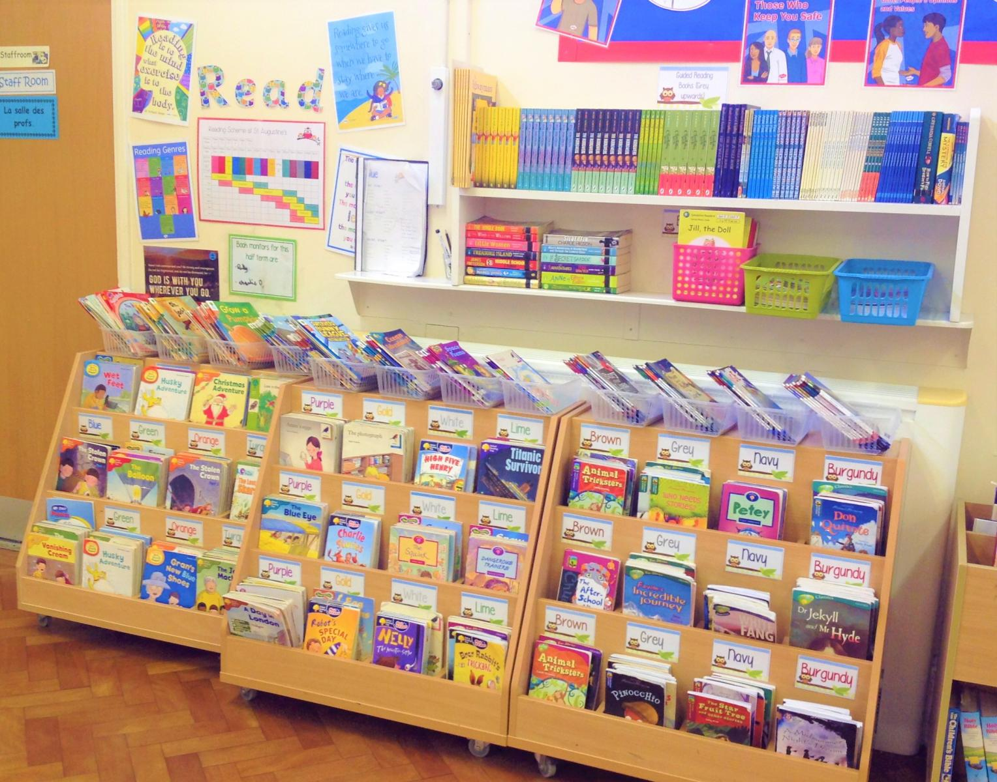
Work with the library;
Use the books you’ve got;
Make sure the reading corners are in order;
Make sure the system is the same throughout the yeargroups.
A child who is reading the wrong level will get bored or frustrated quickly.

Slide 39
6. The most important: you need to listen to them read

Slide 40
All of the studies show that listening to children read is essential to their development
This means, in KG and PYP1-2, hearing each child read for a short period, at least three times a week if possible.
Ideally, you should aim for once a day (you may need support for this).
After PYP2, it may be that you approach it differently, asking the children to read their work outloud, or read off the board. However, don’t let is just be the ones who are good at reading. If they lack confidence, you need to create regular situations where they can read to you without fear.

Slide 41
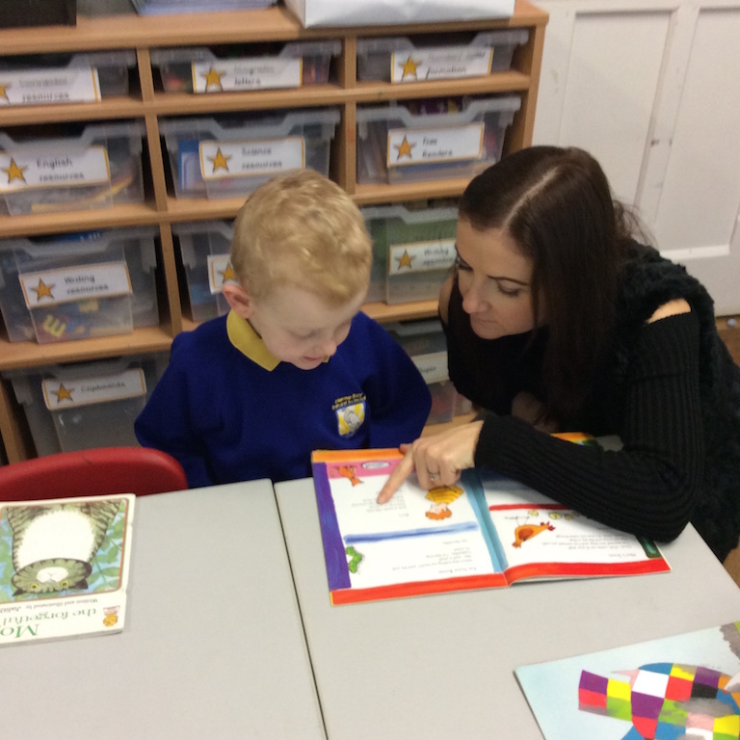
How best to listen to them read
Be interested. Even if you have heard the same thing ten times!
Ask questions as they read: get them to reflect on what is being said.
Help them if they find a word challenging and if they struggle to make sense of a sentence.
Don’t necessarily correct every mistake.
Make notes afterwards.

Slide 42
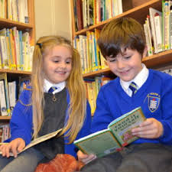
Consider using a reading buddy system
You can pair up children from higher year groups with younger ones to hear them read;
You can pair students in the class with different reading ages to read a book together.

Slide 43
To recap
To read, you must also hear
Teachers must prioritise reading in terms of time and space
Parents should lead by example
You should find what you are interested in reading
You should be pushed to read at the right level
Teachers should listen to the children read aloud regularly

