Slide 1
Summer School 2020 HandBook KG & PYP
SUCCESS IN TEACHING

Slide 2
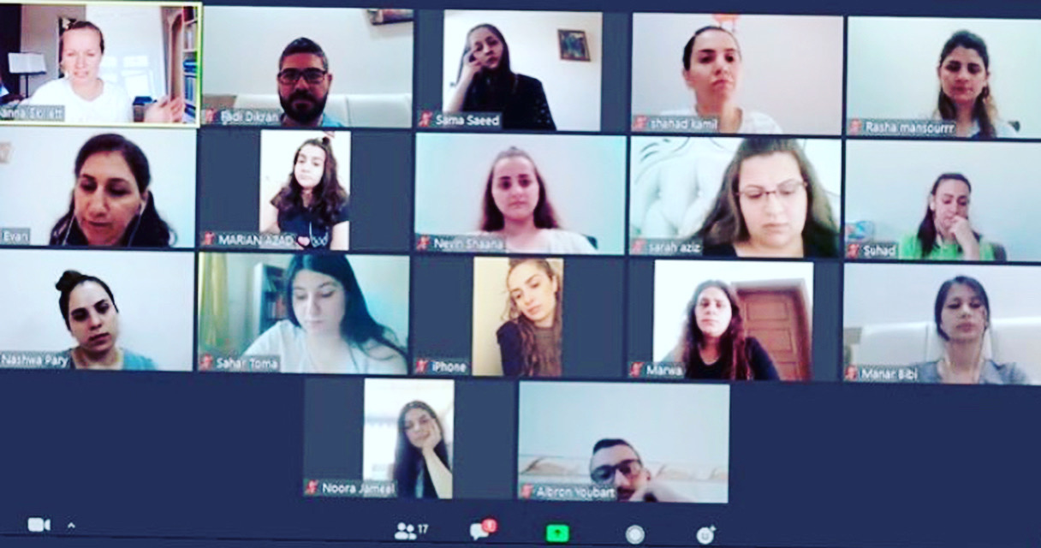
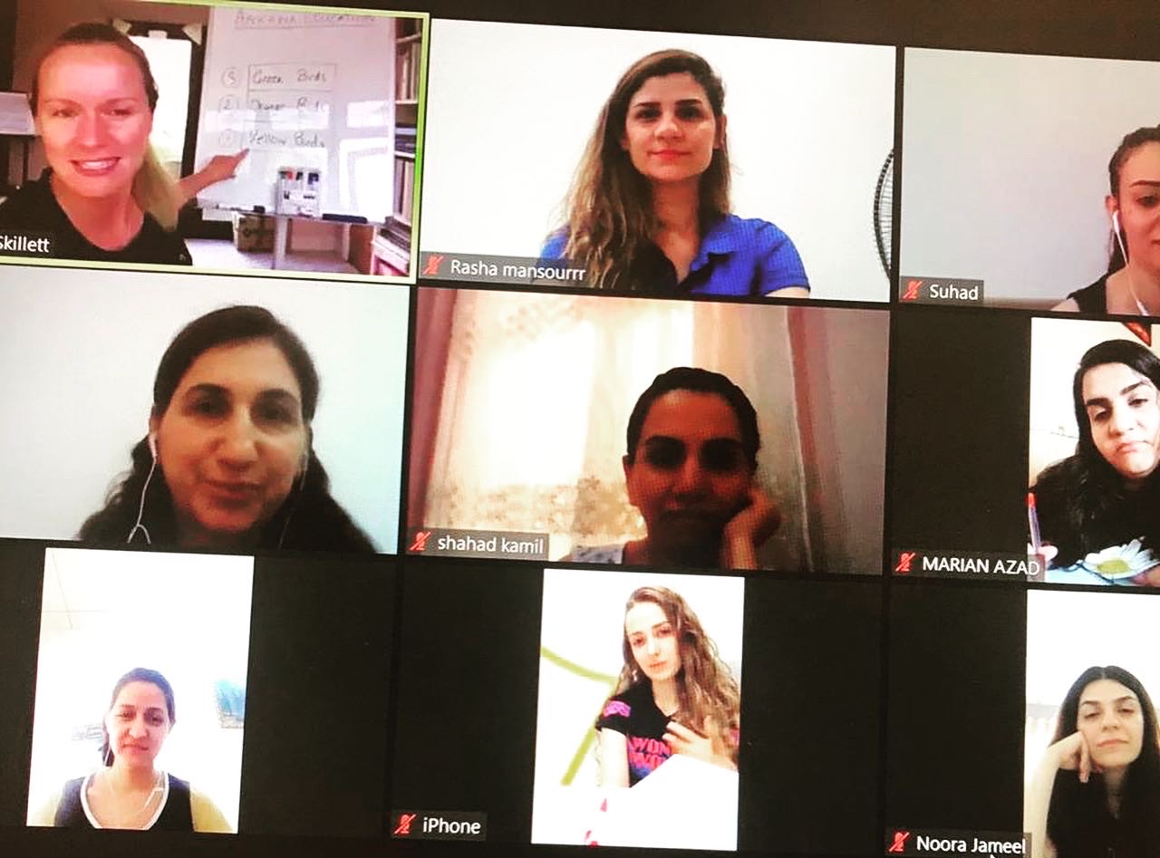
Introduction
Well done on your hard work, focus and determination! ☺
Feedback from UK Teachers has been positive and promising
Thank you for completing great homework to help your learning
This video will be your personal guide on everything you have learnt on this Summer School
Further your own Professional Development from this course
Push yourselves to be the BEST teacher you can be for your students, the School, but most importantly…for YOU! ☺

Slide 3
What have we learnt?
Importance of Individual Lesson Plans and how to complete them
Preparing a Sequence of Lesson Plans for each Subject you teach
Building a Library of Lesson Plans for your Subjects, which builds each Unit
Importance of keeping up-to-date Private Teacher Files, Class Records and Individual Student Records
Importance of Reading every day with every Student in your class
Maintaining great Pastoral Care for all Students and Staff
Working together as a KG & PYP Team - Sharing, Asking Questions and Helping each other
Preparing for Online Learning – making our “online” classroom experience positive and prosperous
Importance of understanding and maintaining Safeguarding in my classroom and the School
Getting to know our new Students and preparing for the School Year ahead

Slide 4
CHECK LIST: LECTURES
LECTURES Have you watched all the daily lectures?
Did you understand their main points?
Talk with your colleagues about the subjects discussed
Have you made good notes that you can understand, keep and use for your teaching?
Keep watching them at www.ankawaeducation.com and visit the site often to “remind and refresh”
…they are very precious gifts from very experienced teachers!
Keep a “Library of Lectures and Lecture Notes” in your Private Teacher File

Slide 5
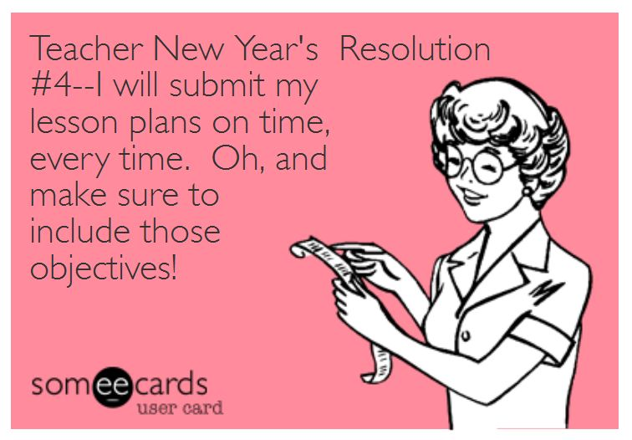
CHECK LIST: Lesson PLan
What is a Lesson Plan? = A Lesson Plan is a teacher’s way of preparing, planning and delivering a successful lesson for their students
MQS KG & PYP now have the same Lesson Plan Format
It is very important that every teacher use this Template from now on to plan every lesson they teach
The more you do, the easier (and quicker!) planning a lesson will become
It will make sure you cover each important area that a teacher must think about for their students to succeed in their learning
An inspector visiting MQS will ask to see your Lesson Plans. You must have a complete Library of Lesson Plans for every lesson that you teach for the whole of the School Year. Keep them safe in your Private Teacher File!

Slide 6
Lesson Plan: HOW TO FILL in each box
Your Name
Your Class Name
1 of the 6
IB Themes
The Unit Name
Is this the 1st for this Subject in this Unit?
Or 2nd , 3rd etc. in the Sequence?
Maths/
Science/
English? …etc.
30mins, 45mins, 1hr?
Calendar Date you teach this lesson:
e.g.- 15.09.20

Slide 7
Lesson Plan: HOW TO FILL in each box
Children know how to count to 5.
Students will know how to count to 10.
English (Writing), Speaking & Listening Skills, Social Studies (Currency/Money), Music (Number Songs), Art & Design, PE
Numbers: 0 – 10, written words “ten”, “Number Line”, “dollars” “dinah”

Slide 8
Lesson Plan: HOW TO FILL in each box
A quick, fun and engaging way of introducing to your students what they are about to learn in your Lesson.
Class Quiz, Interactive Video, Teacher Presentation, Carpet Time, Treasure Hunt, Guess what’s in the Bag?, Class Game… something quick and easy that everyone can do and enjoy ☺
The main activities that you use to help you teach your lesson
Writing, Reading, Presentations, Investigations, Colouring, Drawing, Building, Projects, Essays, Role-Play, Discussions, Interactive Videos
Activities that are correct for your Students and allow you to clearly achieve the Lesson’s Learning Objective

Slide 9
Lesson Plan: HOW TO FILL in each box
Differentiation: Anything that you do in your lesson that helps individual students succeed
Resources for the Lesson: Sentence Starter Worksheets, Visual aids (key vocabulary on their table), adapting the activity for children who need more Support e.g.: starting with smaller Maths sums, using Lego blocks to help them count the numbers clearly.
Teaching Skills: Seating Plans, Student to Student Support, frequent Formative Assessment, Providing clear feedback, Keeping Records of Students work and progress
How will you support EVERY student to achieve the Learning Objective for your lesson?
How will you enable EVERY student to feel included in your lesson?
How will you enable EVERY student to have the confidence to TRY?

Slide 10
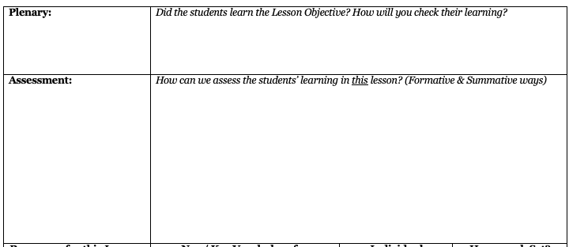
Lesson Plan: HOW TO FILL in each box
An activity for each Student of the class to show what they have learnt in your Lesson.
Examples: Exit Tickets, Quizzes, Group Presentations, Interactive Games, Interactive Videos
How will you check each student achieved the Lesson Objective at the END of the lesson?
There are many ways to check Students are learning successfully:
Formative - throughout the Lesson, to ”form” their learning:
Class discussions, Checklists, Mini-plenaries throughout the Lesson, Observations of Students (individually or in groups), Student to Student Help, Self-Evaluations, Exit Tickets,
Summative – at the end of the Lesson, to ”sum up” the learning:
Final Plenary Activity, Written Tests, Rubrics, Creative Projects, Presentations, Written Work, Written Reports, Practical Examinations, Class Debates, Speaking Listening & Reading Assessment
How can you check each student is achieving the Lesson Objective successfully IN the lesson?

Slide 11
Lesson Plan: HOW TO FILL in each box
Worksheets
Pencils
Lego
Visual Aids – Large numbers
Large Letters for JS
Sentence Starters for Red Table
Students to write their own worksheets of 5 sums to share with a partner next lesson
Numbers
Number Line
Written ”Word” Numbers (nine, ten)
What HW have you set your students?
Help their learning progress and move them on
Just for you.
Make a note of individual students you need to help in their learning and how
A teacher’s “Shopping List”!
What do you need to get ready to teach this lesson successfully?
What are the Key Words that you need your students to understand?
New Words
Hard Words
Important Words

Slide 12
Lesson Plan: HOW TO FILL in each box
Fill this in AFTER you have taught the lesson
What activities did the students enjoy the most?
What were the most successful activities to help you reach the Learning Objective?
What helped you the most in this lesson?
What activities did the students not like?
What would you change about this lesson for next time?
Next lesson for this SUBJECT only
Student will learn about the next number in the series, Number “7”.

Slide 13
LESSON PLANS
Lesson Plans are FUN! They will help you SO MUCH!
A little bit of planning work now will go a LONG way for years to come
You will build your own Library of Lesson Plans that you can use and show other teachers…and inspectors
The new Lesson Plan Template has moved on from Mister Tom’s – to include more boxes for your teaching
All of KG and PYP must use this Lesson Plan Template from now for all of your lessons
These will get easier as you do more – you will get quicker and more confident to plan a successful lesson
LESSON OBJECTIVES = Need to be clear and precise = what the children will learn in THAT specific lesson
ACTIVITIES = Don’t put too much into 1 lesson. Break down your lesson into a few suitable activities and give the children time and support to complete them well
The Plenary is so important and can be used as a way of assessing the students’ learning.
Make sure you fill in the Evaluation Box in your Lesson Plan after you have completed your lesson. This will help you when you teach the lesson again the following year to new students.

Slide 14
WHAT YOU WILL ACHIEVE (EXAMPLE)
THEME
UNIT
SUBJECT
SEQUENCE OF LESSON PLANS
LESSON PLAN 1
LESSON PLAN 2
SUBJECT
SUBJECT
LESSON PLAN 3

Slide 15
AN EXAMPLE (PYP2)
SHARING THE PLANET
HUMANS & HABITATS
SCIENCE
SEQUENCE OF LESSON PLANS
I WONDER
LESSON 1 PLAN
LESSON 2 PLAN
MATHS
LESSON 3 PLAN
ENGLISH
SEQUENCE OF LESSON PLANS
SEQUENCE OF LESSON PLANS
THEME | UNIT | SUBJECT | SEQUENCE | LESSON PLAN

Slide 16
IB words and labels
In the 1st lesson of a New Unit, it would be nice to introduce the students to what they will be learning about over the next few weeks:
The Theme The Central Idea Lines of Enquiry
Do not explain what the large words mean to young Students (KG, PYP1-2)– they will get confused. Keep it simple or say nothing. Just teach it.
Older Students (PYP3-5) could understand that they have a Theme, Units of work to complete, and a Central Idea to think about in their work.
Each Lesson, you should concentrate on a Lesson Objective. Then, you will teach your Students a part of your Unit’s Scope & Sequence. Each lesson, you will teach new parts and they will learn more and more of it until it is complete.
Use suitable IB Learning Experiences (Activities) to include in your Lesson Plans for each Subject for your class. This can help you relate to the Theme and Unit in your Lesson Plans.
Your Key Concepts and Lines of Enquiry are there for you as teachers to guide the students’ learning each lesson. Explore how you can include these in your subjects as you teach but keep it simple.

Slide 17
IB WORDS IN YOUR CLASSROOM PLANNING & TEACHING
Remember that your Lesson Plans are already supporting the students’ IB way of learning by completing their Lesson Objective
The IB requires you to teach at least one interdisciplinary unit per year
An interdisciplinary unit should contain skills and knowledge from more than one subject area = which is what we do all the time as PYP Teachers in Homeroom Teaching. We are always linking ideas to many subjects and allowing students to put them together in projects, presentations and many other parts of students’ work
A transdisciplinary unit should contain skills and knowledge form many subject areas = what we do all the time as PYP Teachers in Homeroom Teaching
We connect the subjects together within the IB Units to always move the student’s learning and understanding on and enrich the Theme
So this how you can help at school make the important “Life Themes” of the IB seem less scary and big for your students…

Slide 18
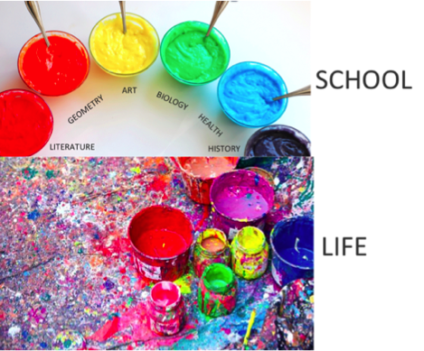
SIMPLE + CLEAR =
THEY WILL LEARN
ALL YEAR!
☺

Slide 19
Examples of how to teach “transdisciplinary”
Activity: Historical Pen Pals Developing creative writing skills in the process whilst writing to a famous Scientist (Scientific discoveries), famous Artist (Art - World Famous paintings) famous Explorer (Geography – World Map, Social Studies – Cultural Differences, History – Landmarks), etc.
Math Gym The game is to practice long jumps (PE – fitness and motor skills). You can talk about how the body uses a “spring” and the “forces” used (Science – Physics) to jump. Then, students can exercise their Math skills by estimating and measuring how far they have jumped (Math – measurement and investigation). These activities and demonstrations can also build into a sequence of lessons about lifting, throwing and other actions – potentially interesting students who don’t usually like the gym!

Slide 20
Examples of how to teach “transdisiplinary”
What are the children learning about? = Beliefs and Values around the World (Social Studies)
So they could find out what is different and what is the same with many religions around the world
With this information, they will be working through:
Maths = to show their data in graphs to analyse the information they have found out
Languages = they will explore new vocabulary that that will help them to create poems and learn about well-know authors of the 20th-century
Art = they will explore their creativity by learning new techniques to paint a self-portrait
Music = students could explore how people express their beliefs and values through Music
…and maybe even write their own song based on the School’s values to develop this project further! ☺

Slide 21
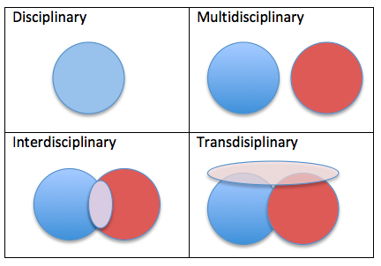
So OUR KG & PYP TEACHING is ALL…
…and our Lesson Plans are clear throughout all our subjects to show how they can work together
Teaching separate subjects and their skills, and then linking them together for a larger idea through Projects, Presentations, School Events etc. is much clearer to teach and much clearer for children to learn ☺

Slide 22
Assessment for learning
ALL the work that you do in class is Formative Assessment
Summative Assessment should be at the END of a Subject / Unit / Theme…e.g.: the destination of the learning journey.
When your class has had time to learn through formative assessment, then you can assess them through summative assessment… and move on.

Slide 23
Why Planning is important
Planning allows YOU to plan for your class for the whole student year
You can see the whole Learning Journey that you must teach the student over the school year
SHORT TERM PLANNING is a Lesson Plan for a lesson that you teach
MEDIUM TERM PLANNING is a completed library of sequenced lesson plans for each iunit that you teach
LONG TERM PLANNING is a complete Scheme of Work for all 6 themes throughout the school year
At MQS Summer School 2020:
Every teacher has started their Short Term Planning = writing their individual Lesson Plans for each lesson they teach
Every teacher has started their Medium Term Planning = writing a sequence of lessons for each subject and completing their Lesson Plans for a whole unit
Going forward:
Every teacher will now start their Long Term Planning = building their Scheme of Work to make their whole year.
This includes planning Events, Linking Subjects…it’s all fun! ☺

Slide 24
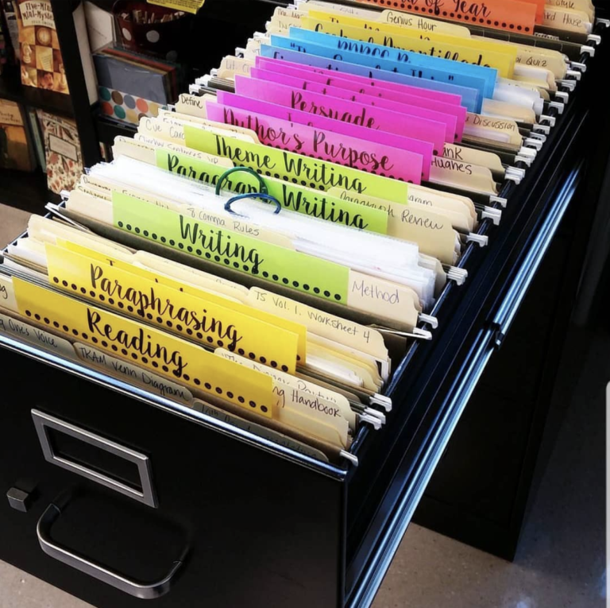
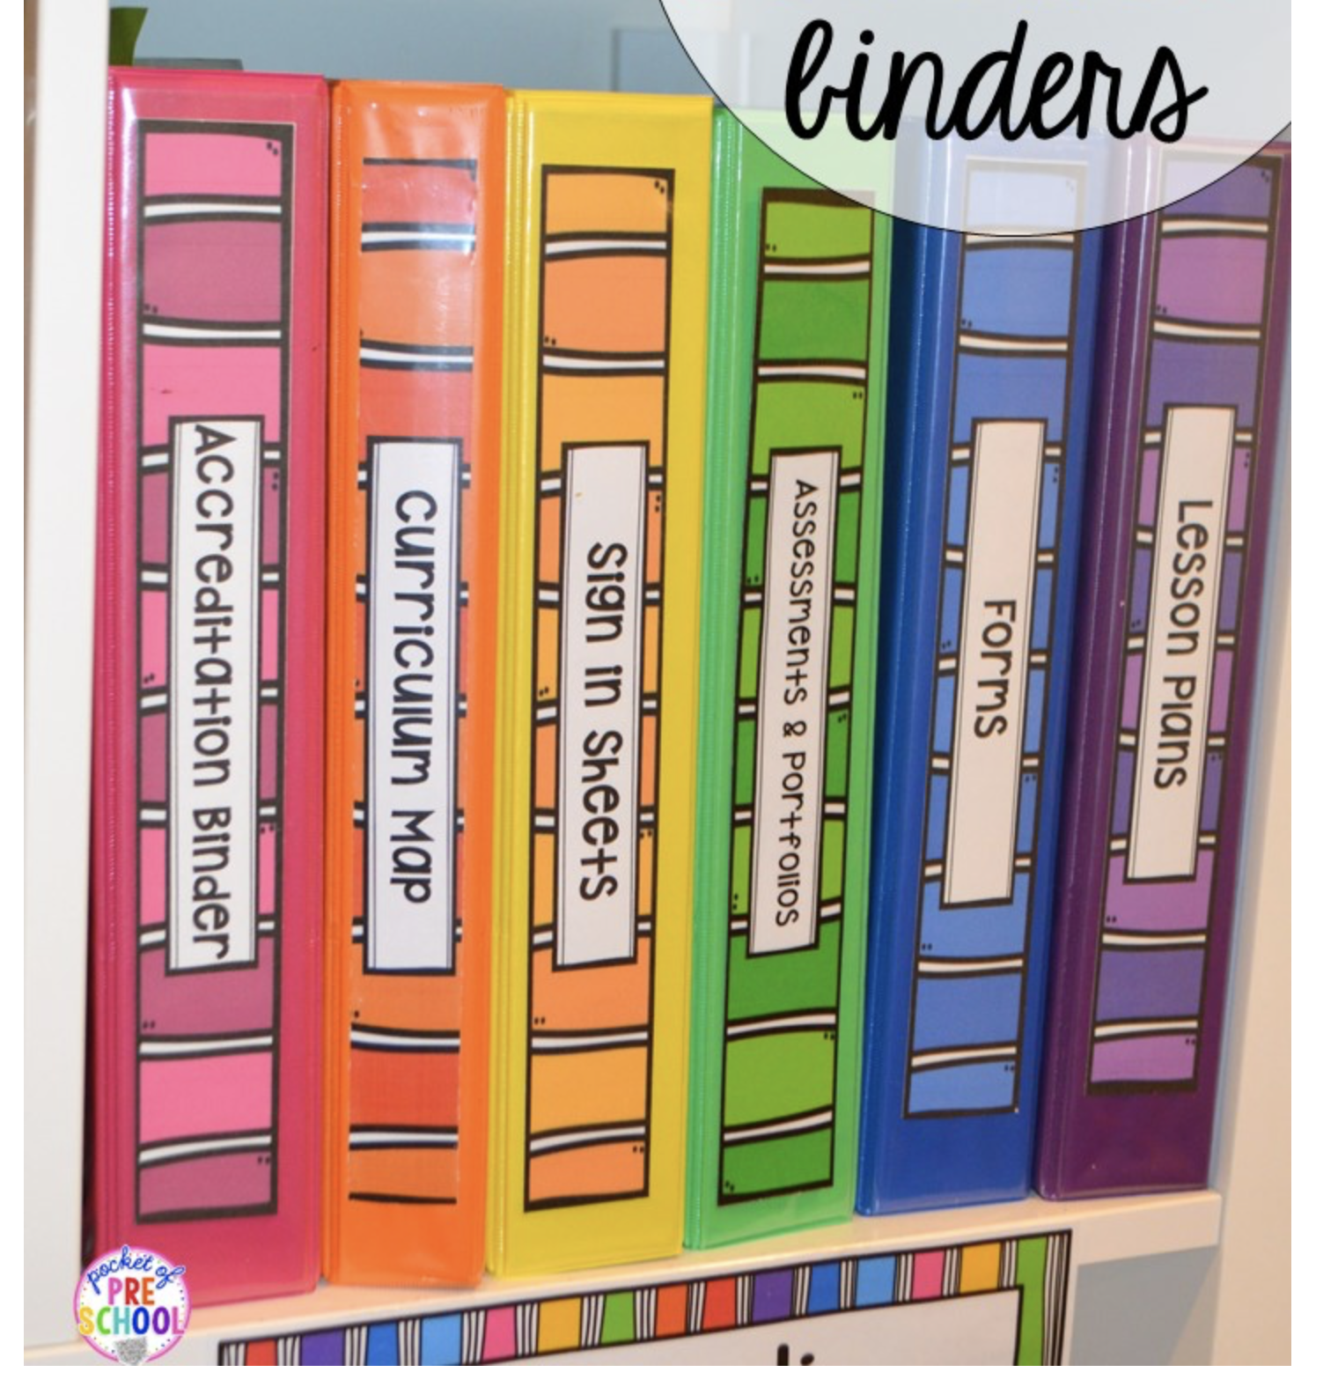
IMPORTANCE OF KEEPING PRIVATE TEACHER RECORDS
Daily Records
Weekly Records
Unit Records
Theme Records
Yearly Records

Slide 25
PRIVATE TEACHER FILE - DAILY RECORDS
Class List of Names Make sure you know the names of your students and keep a list. This will help you:
Keep a note if a student has been off for a long time – they might need extra help to catch up
Keep a record of what students have had awards/class jobs/opportunities such as “Star of the Week”, so you can make sure everyone has a fair chance and feels included
Class Seating Plan Make a class Seating Plan for your students
- After a few weeks when you know them better, you can change them around and seat them in ability levels, mixed ability pairs to support each other, etc. Find out what works best for your students and how you would like to run your classroom for learning
Reading Logs When you listen to a student read 1:1, keep a record of their progress in the Reading Log:
- KG 1 & 2 - Listen to each student read every day and write in the log each time
- PYP 1,2,3,4&5 - Listen to each student read at least 2-3 times per week and write in the log each time
Lesson Plans Make sure you have your Lesson Plans for that day open on your computer to help you teach
- At the end of the day, write a very short review to keep in the Evaluation Box on each Lesson Plan and SAVE the file again to update it

Slide 26
PRIVATE TEACHER FILE – WEEKLY & Unit RECORDS (Short & mEDIUM-tERM plANNING)
Weekly Timetable This will make sure you know what you are teaching and when for the whole week. THIS IS VERY HELPFUL FOR TEACHERS TO KEEP.
You can plan carefully how many lessons of every subject you will teach and how much your students will learn in 1 week
Assessment Results Any Summative Tests/Quizzes that your students take, keep a record of the results and progress for all subjects for each student in a Subject Mark Book. There needs to be 1 Subject Mark Book kept for every Subject that you teach in the year
You will then be able to see how well they have understood each topic in the subject clearly = SHORT TERM MARK BOOK
For Example: John got 7/10 on the 1st Topic Science Quiz in Week 1
John got 8/10 on the 2nd Topic Science Quiz in Week 2
Teacher Notes: John has shown a good understanding of Science
You can ask him more challenging formative questions in your next lesson to help him make more progress in his Learning
Amy got 3/10 on the 1st Topic Science Quiz in Week 1
Amy got 4/10 on the 2nd Topic Science Quiz in Week 2
Teacher Notes: Amy is not strong in Science. Amy needs more support with Science and you can plan for this in your Lesson Plan
^ Because you have recorded this, you can see how to support your student
and use differentiation in your planning to support individual student needs in science for both John and Amy

Slide 27
SIMPLE EXAMPLE OF a SUBJECT MARK BOOK
Change these details for:
*Every Subject
*Every Unit
*Every School Year
Write the name of the Quiz / Test Here.
E.G. – Plants Quiz 1
Write the date the Test / Exam / Quiz was taken
How many questions does the Test / Quiz have?
= 10?
Write this number for each test so we know how well the student has done
Write your students’ names in alphabetical order
These are the Student’s Results every time you have Test / Quiz / Exam for this Subject.
Write them down for every student, for every test.
YOU MUST KEEP YOUR MARKBOOK UP TO DATE FOR EVERY TEST, EVERY RESULT AND EVERY STUDENT

Slide 28
WHY RECORDING STUDENT RESULTS IS IMPORTANT
They are a record of every End of Subject, or End of Unit, or End of Theme Summative Assessment that your students will take over the whole school year
This information will be used by the school to follow the student through their Learning Journey
For you, the teacher, this is a VERY IMPORTANT RECORD of the work you have taught and how well your lessons have achieved their Learning Objective, because these marks will show if a student remembers and understands what you have taught them
These records can also be used to show the student’s next teacher the level of each student at the end of the school year (e.g.- PYP1 shows PYP2)
So YOU can also look at another teacher’s records and see how best to prepare to help a student the most in your class in the next school year (e.g.- PYP1 will look at KG2’s records)
You can change the titles of the sheets to suit your class and student age group, and change the type of assessment to what YOU think works best to record the progress of each student in your class. Whatever assessment you do….make sure you keep very clear, up-to-date
Individual Student Progress Records! ☺

Slide 29
COLE’S COLOUR CODE (mid & Long Term mark book)
As a class teacher, you will record the test results of every student in every subject you teach in a Subject MarkBook like on slide 29. (Go back to look at it carefully). I have sent you this template in your resources to use and edit to suit your class and each subject
You also need to keep a Student Yearly Progress Record of every student’s progress from unit to unit, which will show you their larger journey of progress throughout the whole school year =MID AND LONG TERM PLANNING
We shall use the ‘Cole Colour Code’ (the CCC). Please watch Jane Cole’s lecture on The Use of Student Data to remember how to use it correctly
There are 4 colours that each teacher will use to assess your students’ progress in each subject for the whole year
You need to use the results in your Student Mark Book to find out what colour to give to your student at the end of the unit
I will send you a Student Mark Book and a Student Yearly Progress Record template that you can use easily for your classes

Slide 30
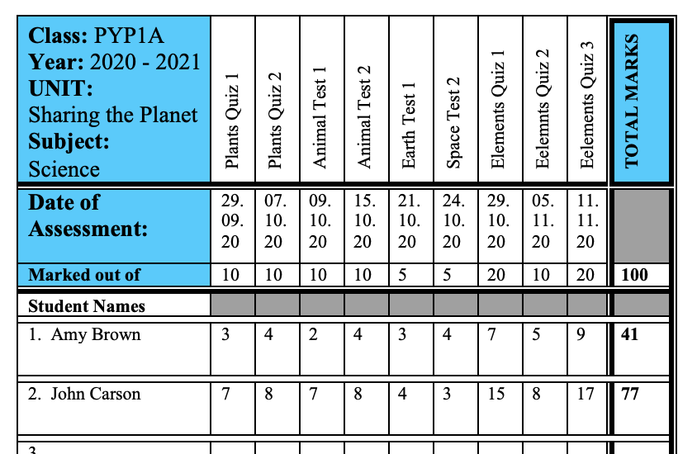
HOW TO FILL IN THE YEAR PROGRESS RECORD 1. FIND TOTAL student mark AND total number of questions
Total Number of Questions = 100
Amy’s Total Student Mark = 41
John’s Total Student Mark = 77
Amy got 41 marks out of a possible 100. This means that Amy scored 41% in Science for this Unit
John got 77 marks out of a possible 100. This means that John scored 77% in Science for this Unit

Slide 31
2. ADD THE right colour to each student
You must now put the right colour for each student in your Student Year Progress Report
This will show what progress they have made at the end of every unit
You must fill this in after every unit for ever subject throughout the school year
GREEN
76 – 100%
YELLOW
51 – 76%
RED
0 – 25%
ORANGE
26 – 50%
John (77) would be Green for
Science Unit 1
Amy (41) would be Orange for
Science Unit 1

Slide 32
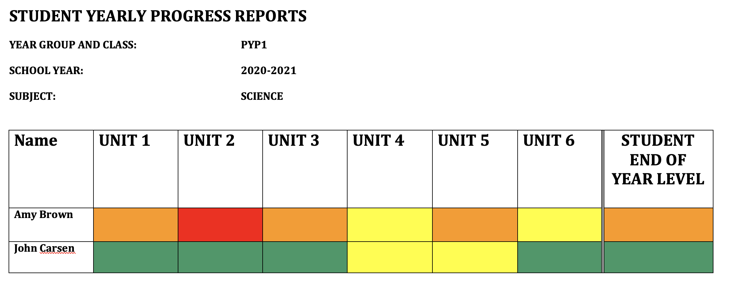
STUDENT YEARLY PROGRESS REPORT
Then, you can see clearly and easily show each student’s total progression over the whole year on 1 page
This is the record you can show their next teacher (e.g.- PYP1 show PYP2, etc.) to help continue the student’s learning successfully in their next school year
It is clear how well the student has understood the subject at that year in school
If everyone uses the same template and code, then everyone will understand how to read it and it will work easily
Remember, Yellow Level in PYP1 is different to Yellow Level in PYP4, as the level of work gets harder in each PYP year
But each teacher uses the same method to find the right colour for each student in their class
This is also much easier for parents to understand their child’s learning progress. But make sure you only show them their own child’s results and no more

Slide 33
STEP BY STEP…
Keep a Subject Mark Book for your class – Record all the information and results from your summative assessments in a unit for each student
When you finish a Unit, find their final % of progress on the Subject Mark Book by always using this simple Sum:
The Number of Answers Correct in all Tests Number of Questions in all Tests
100
For example: Omar had 57 correct answers in all his 1st Unit Science tests
There were 120 questions in all his tests
57 120 100 = 47.5%
Omar’s Colour for his 1st Unit Science in his Student Yearly Progress Report is ORANGE

Slide 34
Keep a record…
Formative Assessment
*Class Quizzes
*Teacher Observations
*Mini-Plenaries
*Class / Group / Solo Presentation
*Class Discussions / Debates
*Creating Diagrams/Posters
& other student learning evidence
*Classwork / Homework
*Writing
*Exit Tickets
*Role-play
*Pair-work / Student to Student Support
Summative Assessment
*Rubric Marks
*End of Unit Tests / Quizzes /
Projects / Presentations
*End of Theme Tests / Projects
*Scores that are used
to record a Student’s progress
over the entire School Year
*Essays
*End of Year Test / Projects
Both are ways to assess your students
Both need to be used effectively
Both can be used for Student Feedback
Both need to be planned and written in your Teacher Planning

Slide 35
PRIVATE TEACHER FILE – WHAT IS INSIDE IT?
Student Class Register – Have a list of names of the students in your class
Student 1 page-profile – Keep a private file of information on each student given to you by their previous teacher, Admin or notes that you have added throughout the year
Class Weekly Timetable for every week you teach – to see what you are teaching and what lesson number you are on
Student Subject Mark Book – every Subject’s Summative Assessment Marks for every student in your class throughout each unit
Student Yearly Progress Report – give every student a Progress Colour Level for every subject at the end of each Unit throughout the school year
A Library of Lesson Plans – Short Term Planning (STP) – a Lesson Plan for every lesson you teach
A Unit Scheme of Work – Medium Term Planning (MTP) – to follow and help you write a good Lesson Plan (STP)
The Themes of the Whole Year – Long Term Planning (LTP) – any information about the Themes that will help your STP & MTP
Student Reading Logs – Every student’s Individual Reading Log so you can keep a record of when they read 1:1 with you
It is YOUR responsibility as a teacher to keep all these files up-to-date for your class
throughout the school year.

Slide 36
Why Is Reading so important?

Slide 37
STUDENT LEARNING AND DEVELOPMENT…

Slide 38
TEACH THEM THE JOY AND POWER OF READING
Remember to always encourage the children to read for pleasure – those who read succeed!
Think about starting some special Reading Theme Activities for your school and class:
Book of the Week Share your Reading Book World Book Day (Thursday 4th March) Write a Class Story
Talk about your own joy of reading and read to your students at least once a day
There are many different classroom situations where your students can read:
Whole Class Reading Small Group Reading Reading in Pairs Quiet Time Reading Homework Reading
Reading Instructions Guided Reading Reading aloud for the Class Reading Reward Time Mentor Reading
…and include Literacy Games (Treasure Hunts, Crosswords, Riddles, Scrabble, Make smaller words out of 1 larger word, etc.)
If you have to teach online, reading with your students every day can still be done! Watch Mr Tom’s lecture again on the importance of reading and his very helpful guide to finding online resources for reading in English
Find any opportunity to allow the students to read, practice and succeed!

Slide 39
READING CORNERS IN YOUR CLASSROOM
The Reading Corners in your classroom can be an important lifeline for students who want to read independently
Having a welcoming Reading Scheme to help guide the students to their correct level is vital
Your School Librarian is very keen to put a Reading Scheme throughout the whole school
Arrange a meeting with the Librarian to discuss suitable books for your classroom for 3 levels of students (Intro, Intermediate, Advanced)
Make sure the Reading Corners are welcoming, clear, signposted well and suitable for your age group
Perhaps have some teddy bears in your Reading Corner that the younger children can read to
Consider having more than 1 copy of the same book so older children can read at the same time with friends
Reading Corners are to encourage independent reading
Prepare clear and suitable displays and posters to make it attractive for students to visit and read
Consider featuring a short “Book of the Week” and ask students to read it and write a Book Review for the wall display
If a student has worked well in your lesson and has finished their work successfully, reward them with 10mins free time to read in the Reading Corner

Slide 40
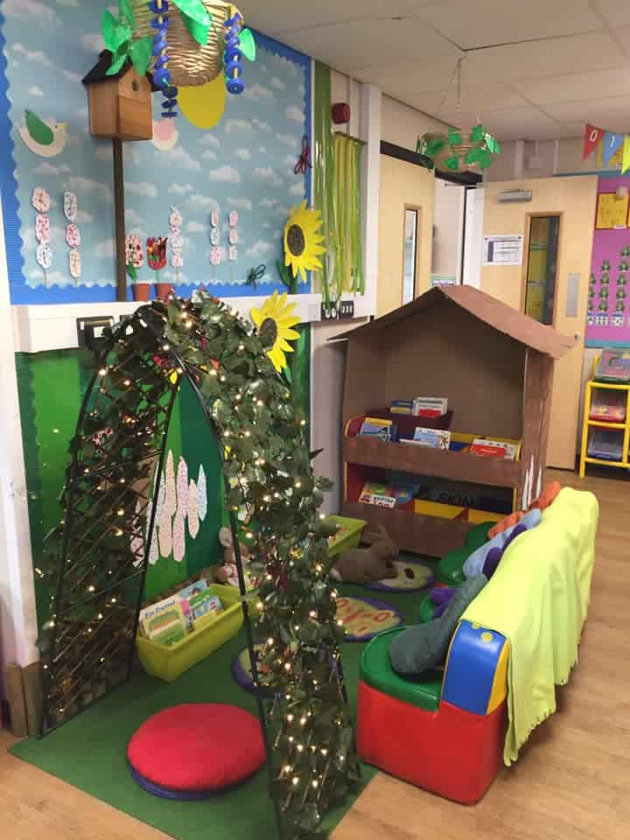
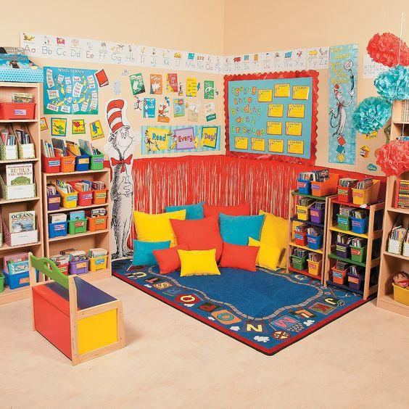
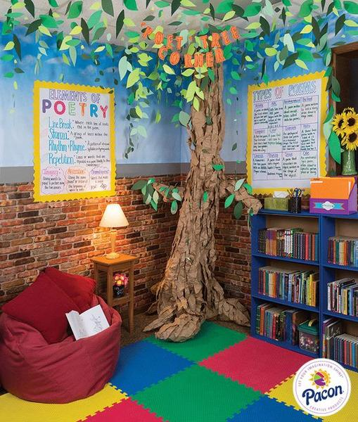
INSPIRATION TO DESIGN AND MAKE YOUR own READING CORNERS…

Slide 41
NEXT STEPS for MQS CLASS AND GROUP READING
Arrange a meeting with the School Librarian and discuss the following:
1). Schedule a Class Weekly Trip to the School Library for every child to borrow a book. This visit is a TREAT and should be respected, so they can earn it with hard work in class and look forward to each week
2). Organise suitable books from the Library to be used in your Reading Corners as part of the Whole School Reading Scheme
3). Talk to the School Librarian about creating Book & Author Theme Days and Events, “Meet the Librarian” sessions to learn about the rules and respect for the Library and its books, and other creative ideas to build into your school reading
4). Be active from Day 1 and help to create a positive, active, daily reading environment for MQS and its students
5). Work together as a staff team to discuss with the Librarian what the Whole School Reading Scheme should be and how you can follow it in your own class

Slide 42
NEXT STEPS for MQS INDIVIDUAL STUDENT READING
It is incredibly important to monitor and track each student’s reading level individually for progress and improvements
For KG, this will be working through the levels of phonic sounds and high frequency words. Perhaps it will be short sentences or even short books by the time they reach KG2
For PYP 1-5, this will be the official start of their reading books from the Whole School Reading Scheme
For KG, PYP 1 & 2, teachers must listen to their students read for at least 5 minutes 1:1 with you every day
For PYP 3&5, teachers must listen to their students read for at least 5 minutes 1:1 with you at least 3-5 times a week.
Start other weekly opportunities for individual reading in your school:
- PYP4/5 students could mentor PYP1/2/3 students and listen to them read as part of a Reading Mentor Programme
- Older students could read to small groups of younger children, or even a whole class
- A school teacher and older students could hold Book Clubs together and talk about the books they are reading
- Younger Year Book Clubs and activities around Story-Time can also take place during the weeks as clubs for students

Slide 43
READING LOG RECORDS
You must keep a record of every time you hear a student read
You must note the Date, Title of Book and comments about the student’s reading skills that day
You must note any hard words/sounds they struggle with and mention if they were able to talk to you about the book. This is called working on their comprehension…e.g.- did they understand and can they explain what they are reading about?
For example, ask the student a question about something that has happened in their book:
Teacher: “But why did the girl look left and right before she crossed the road?”
Student: “Because there might be cars and you need to be safe. You must wait and look before crossing the road.”
The student here has shown good comprehension of what they have read.
It is not enough to be able to READ the words in the book. They must UNDERSTAND and EXPLAIN their meaning successfully too.

Slide 44
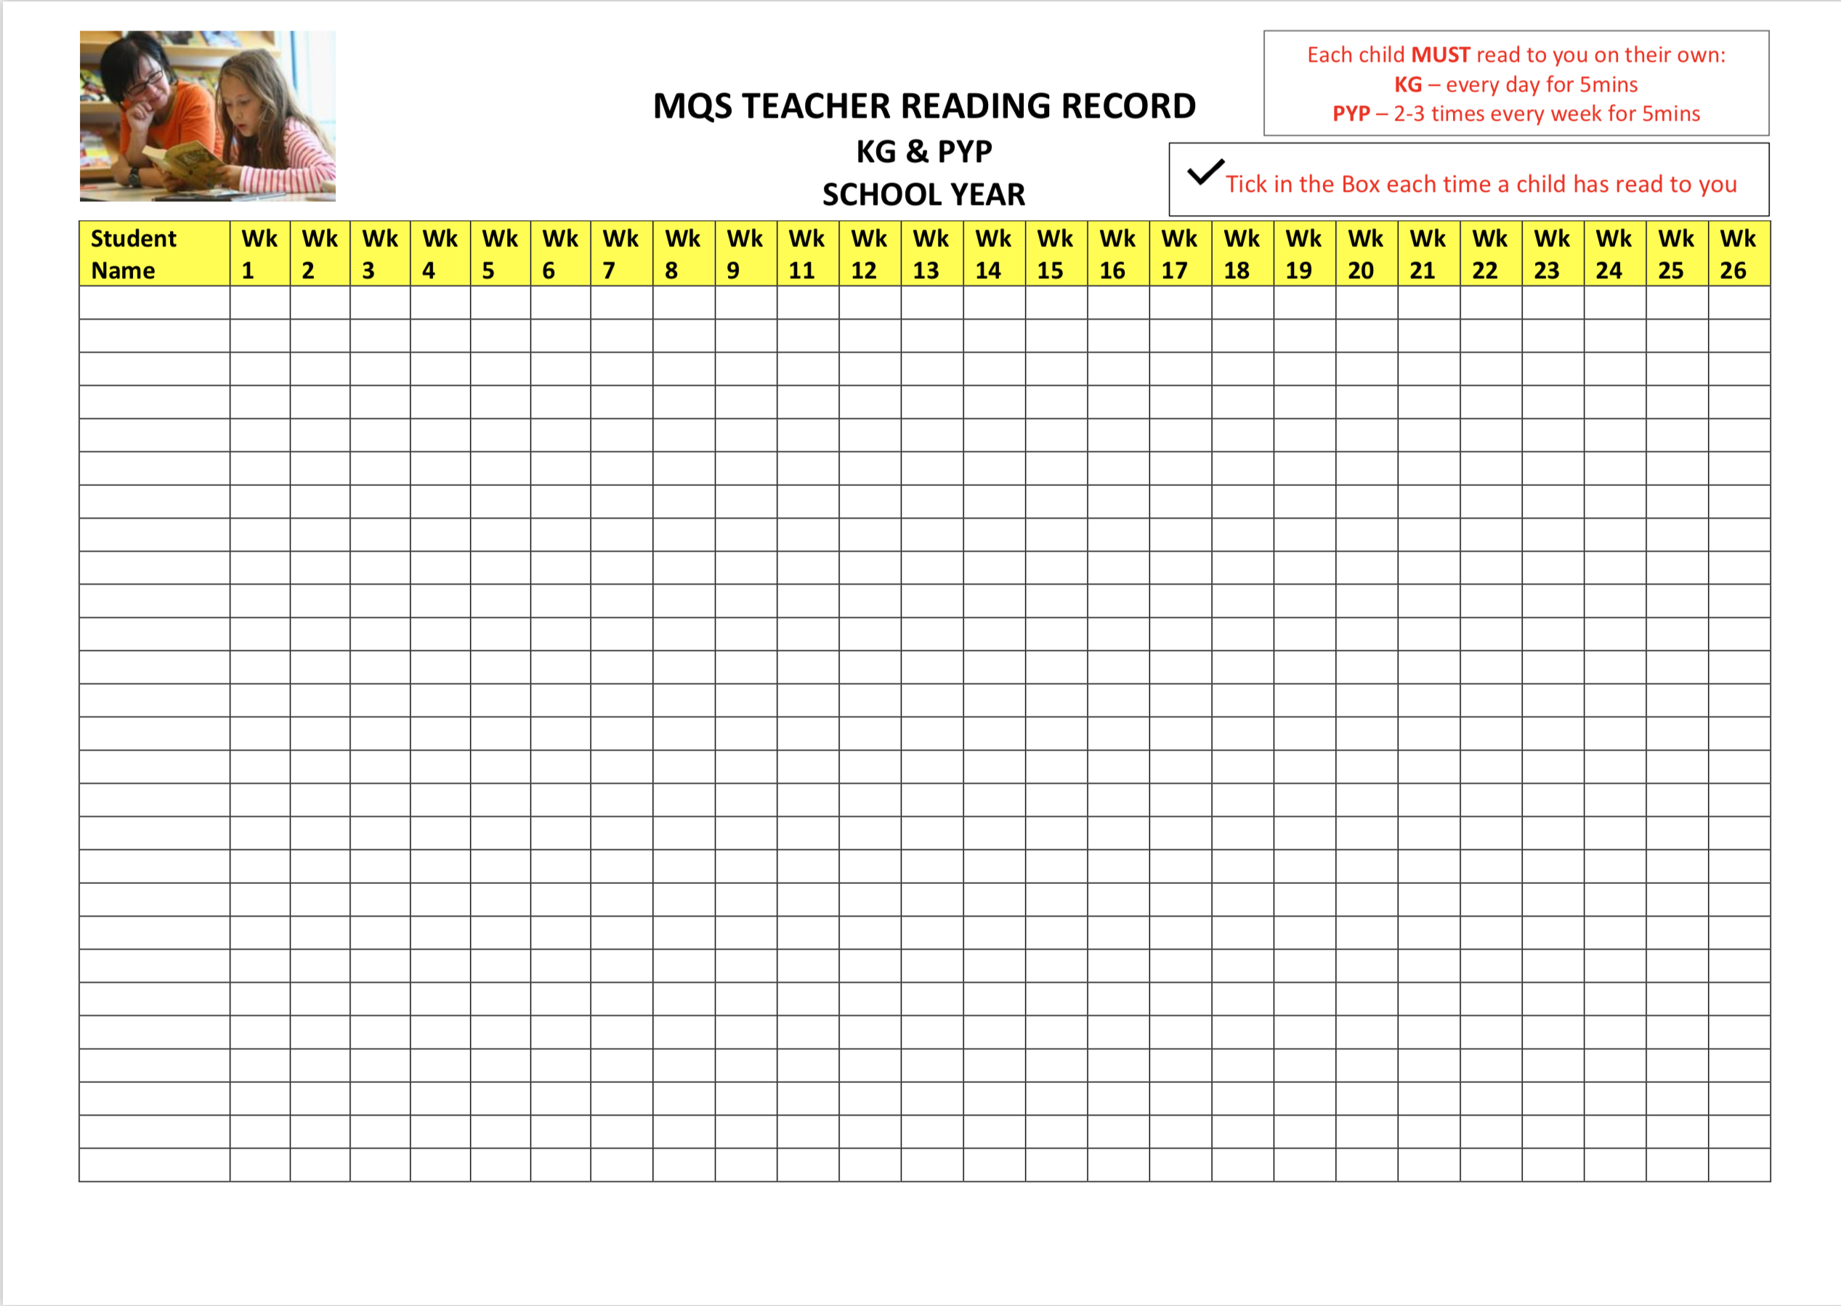
EXAMPLE OF SCHOOL READING LOG

Slide 45
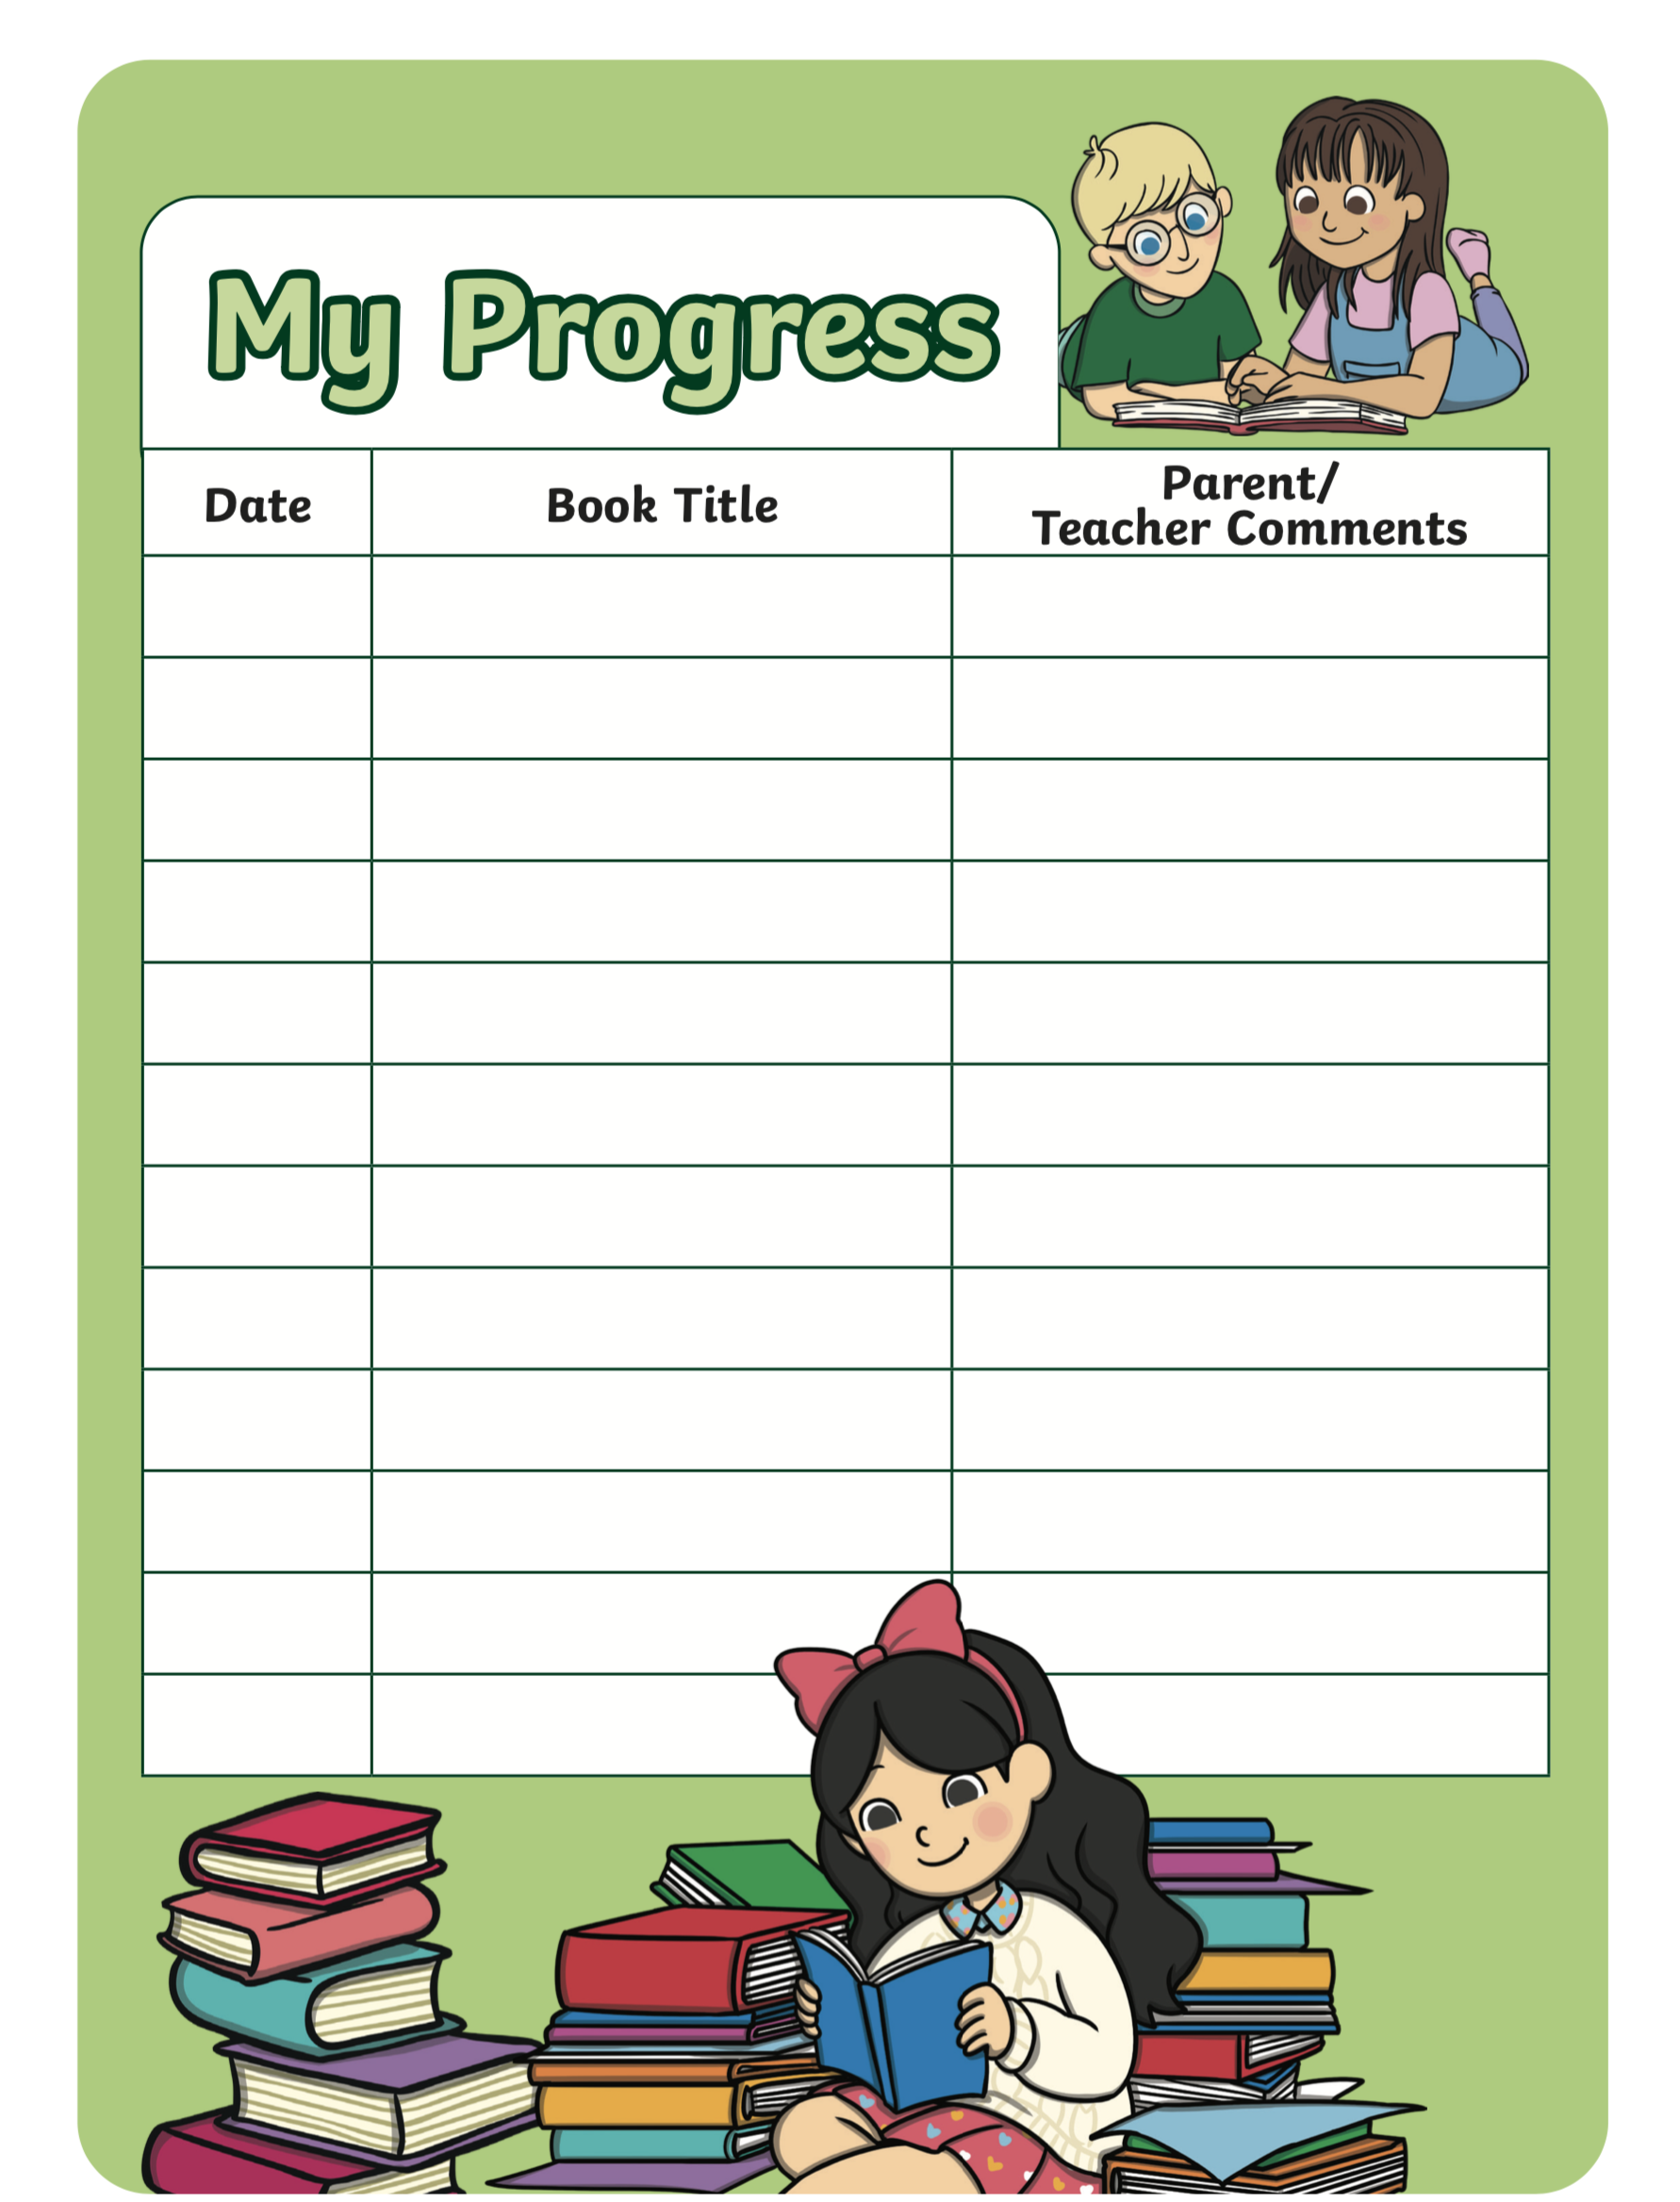
EXAMPLE OF SCHOOL READING LOG

Slide 46
Pastoral care
Maintain a high level of great pastoral care to ensure a safe, secure learning environment in every classroom and around the school throughout the school year
Get to know the students - consider the “Welcome Pack” to ‘break the ice’ when they start in September as a new class
“Teach, Talk, Tell” - regularly teach your students about the importance of keeping ‘them and all, safe in school’. This can include lessons, events, activities on preventing bullying and cyber-bullying, misuse of mobile phones/technology, how to report bad behaviour and building a ground of trust between you (the staff) and them (the students) to build a successful and safe school
If a student tells you something that worries you, you NEVER keep this a secret. You must tell your Head of Safeguarding immediately
There are 4 types of abuse: Physical, Sexual, Emotional and Neglect. All staff should be taught how to identify and deal with signs of abuse.
Remember that Safeguarding MUST be in place at a school to protect the students and also to protect YOU as staff.

Slide 47
safeguarding
TEACH
TALK
TELL
TEACH
students the importance of Safeguarding in class regularly
TALK
to students about ‘what to do’ if they have or hear about an issue
TELL
the Head of Safeguarding immediately and NEVER keep it a secret!

Slide 48
WORKING TOGETHER AS A TEAM
The power behind a school is the power of its learning – for both students AND teachers
In order to succeed with transdisciplinary teaching, teachers need to be involved and collaborate together
In order for your students to succeed, you must support each other and prepare the student well for their journey from Day 1 of KG1 to their last day in MYP
In order for MQS to succeed, you MUST work together as a KG & PYP complete team
Do you know all of your MQS colleagues? Knowledge is power! More teachers on your team = more brains!
Our job as teachers is to set the best example for our students and to work together as a team successfully.
How can we expect to ask this of our students if we cannot do it for ourselves?
In order to do this, you need to meet regularly to ensure you are supported, up-to-date with all new school information and your records are complete:

Slide 49
STAFF MEETINGS AND GOOD COMMUNCATION
In your individual years, you must hold Weekly Year Group Planning Meetings to talk about the Day, Week, Unit, Theme and School Year ahead as appropriate, around 2-3 times per week
Hold FULL KG & PYP Staff Meetings once a week and talk about: Positive Results, Schemes of Work, Important Upcoming Events, Share Students Work, Organise cross-curricular and cross-year group events, Whole School Events and talk about Safeguarding Issues, Training and Support
Rotate each teacher (or PYP Coordinator) to lead each Staff Meeting and help to keep communication and decisions moving along positively
Remember, meetings are a way of supporting you and your team. Take part, be active and respectful and work together to improve your school.
3. At the end of a school year, when students are moving into their next class, you must organise a Transition Meeting (or a few meetings) with the teacher who has taught them previously (E.G.- PYP1 would meet with KG2)
- In this meeting, you should discuss each pupil privately (with the classroom door shut) and share records of assessment, progress reports, 1- page student profiles and personality so you can to give the student the best year ahead
- You should also have a transition meeting for your student’s next teacher as they move up the School (E.G.- PYP1 should do this to help PYP2) If you are PYP5, arrange a meeting and talk to MYP1
- If you are KG1, you may want to reach out with a Welcome Pack to your prospective parents and students and invite them for a “Taster Session” of what it is like to be in school for a day (a short morning visit) – the kids would be very excited! This would also give you the opportunity to meet them and get to know the students (and parents!) arriving to the School that September for KG1

Slide 50
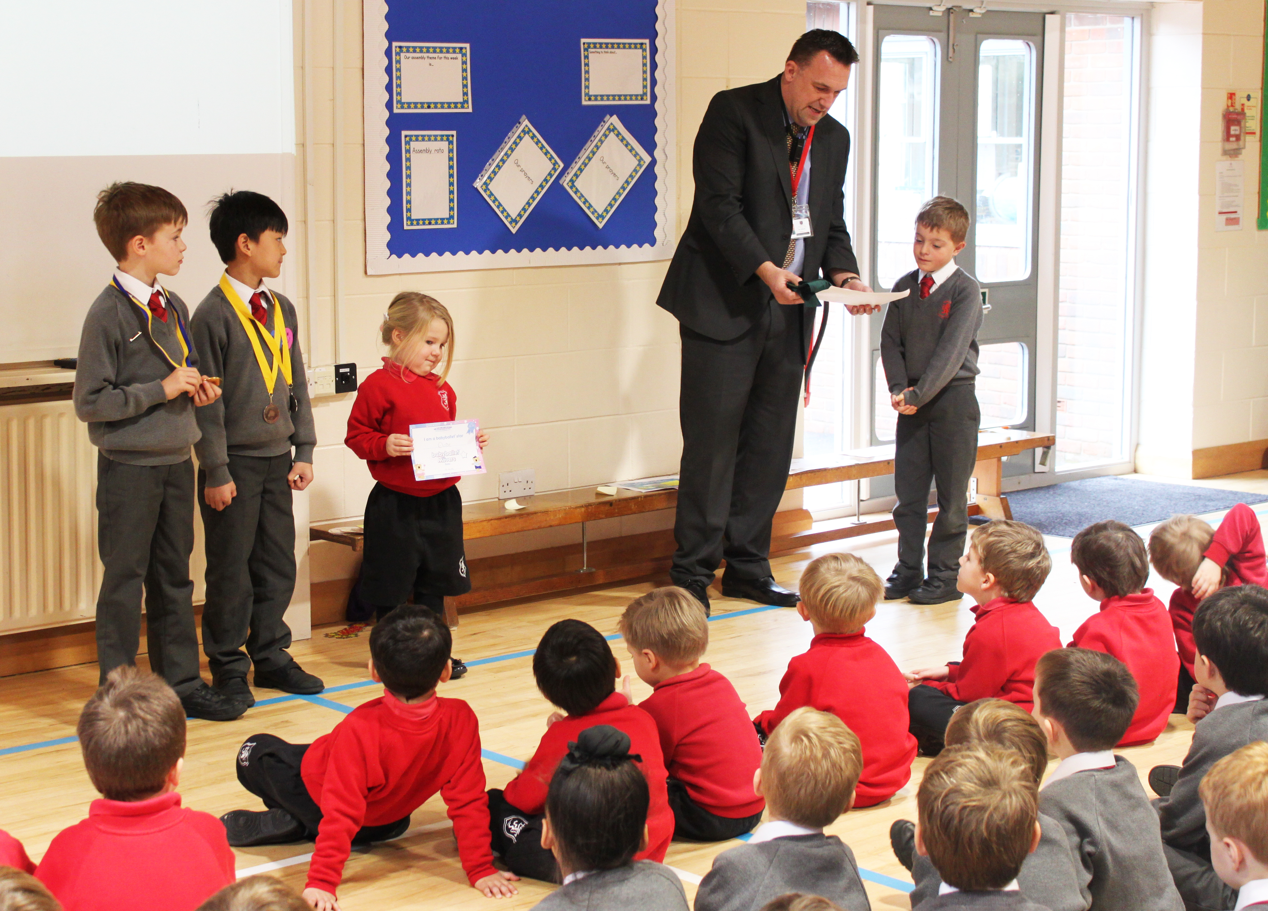
PUPIL MEETINGS AND COMMUNICATION
Make sure that you are holding at least:
1 weekly Assembly with your Year Group
AND
1 weekly / fortnightly Whole School Prayers followed by an Assembly with ALL of KG & PYP together - maybe in the Hall?
Take it in turns as teachers to lead the Whole School Assembly. Introduce yourself and talk about what each class has been learning this week.
- Perhaps invite a student to come to the front and join from each class to show the school some of their work?
School Stars of the Week
Introduce this Whole School Reward system to MQS. Every HomeRoom teacher is to pick their “Class Star” who has worked very hard that week.
They are given a certificate signed by you (their teacher) and the Head! …..OH WOW! ☺
They are presented it with it in front of the whole school, by the Head and have their photo taken…..OH WOOOOW! ☺☺
They get to take it home and keep it…and show their family and friends….OH WOOOOOOOWIE! ☺ ☺ ☺
*Remember, the School Star can be any level of student who has made progress. It should not just be the student who got 10/10.
Make sure each child get School Star of the Week at least once in every School Year…pick your moments well! ;-)

Slide 51
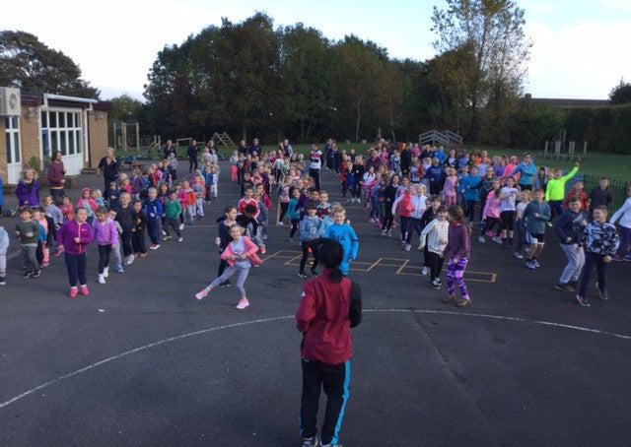
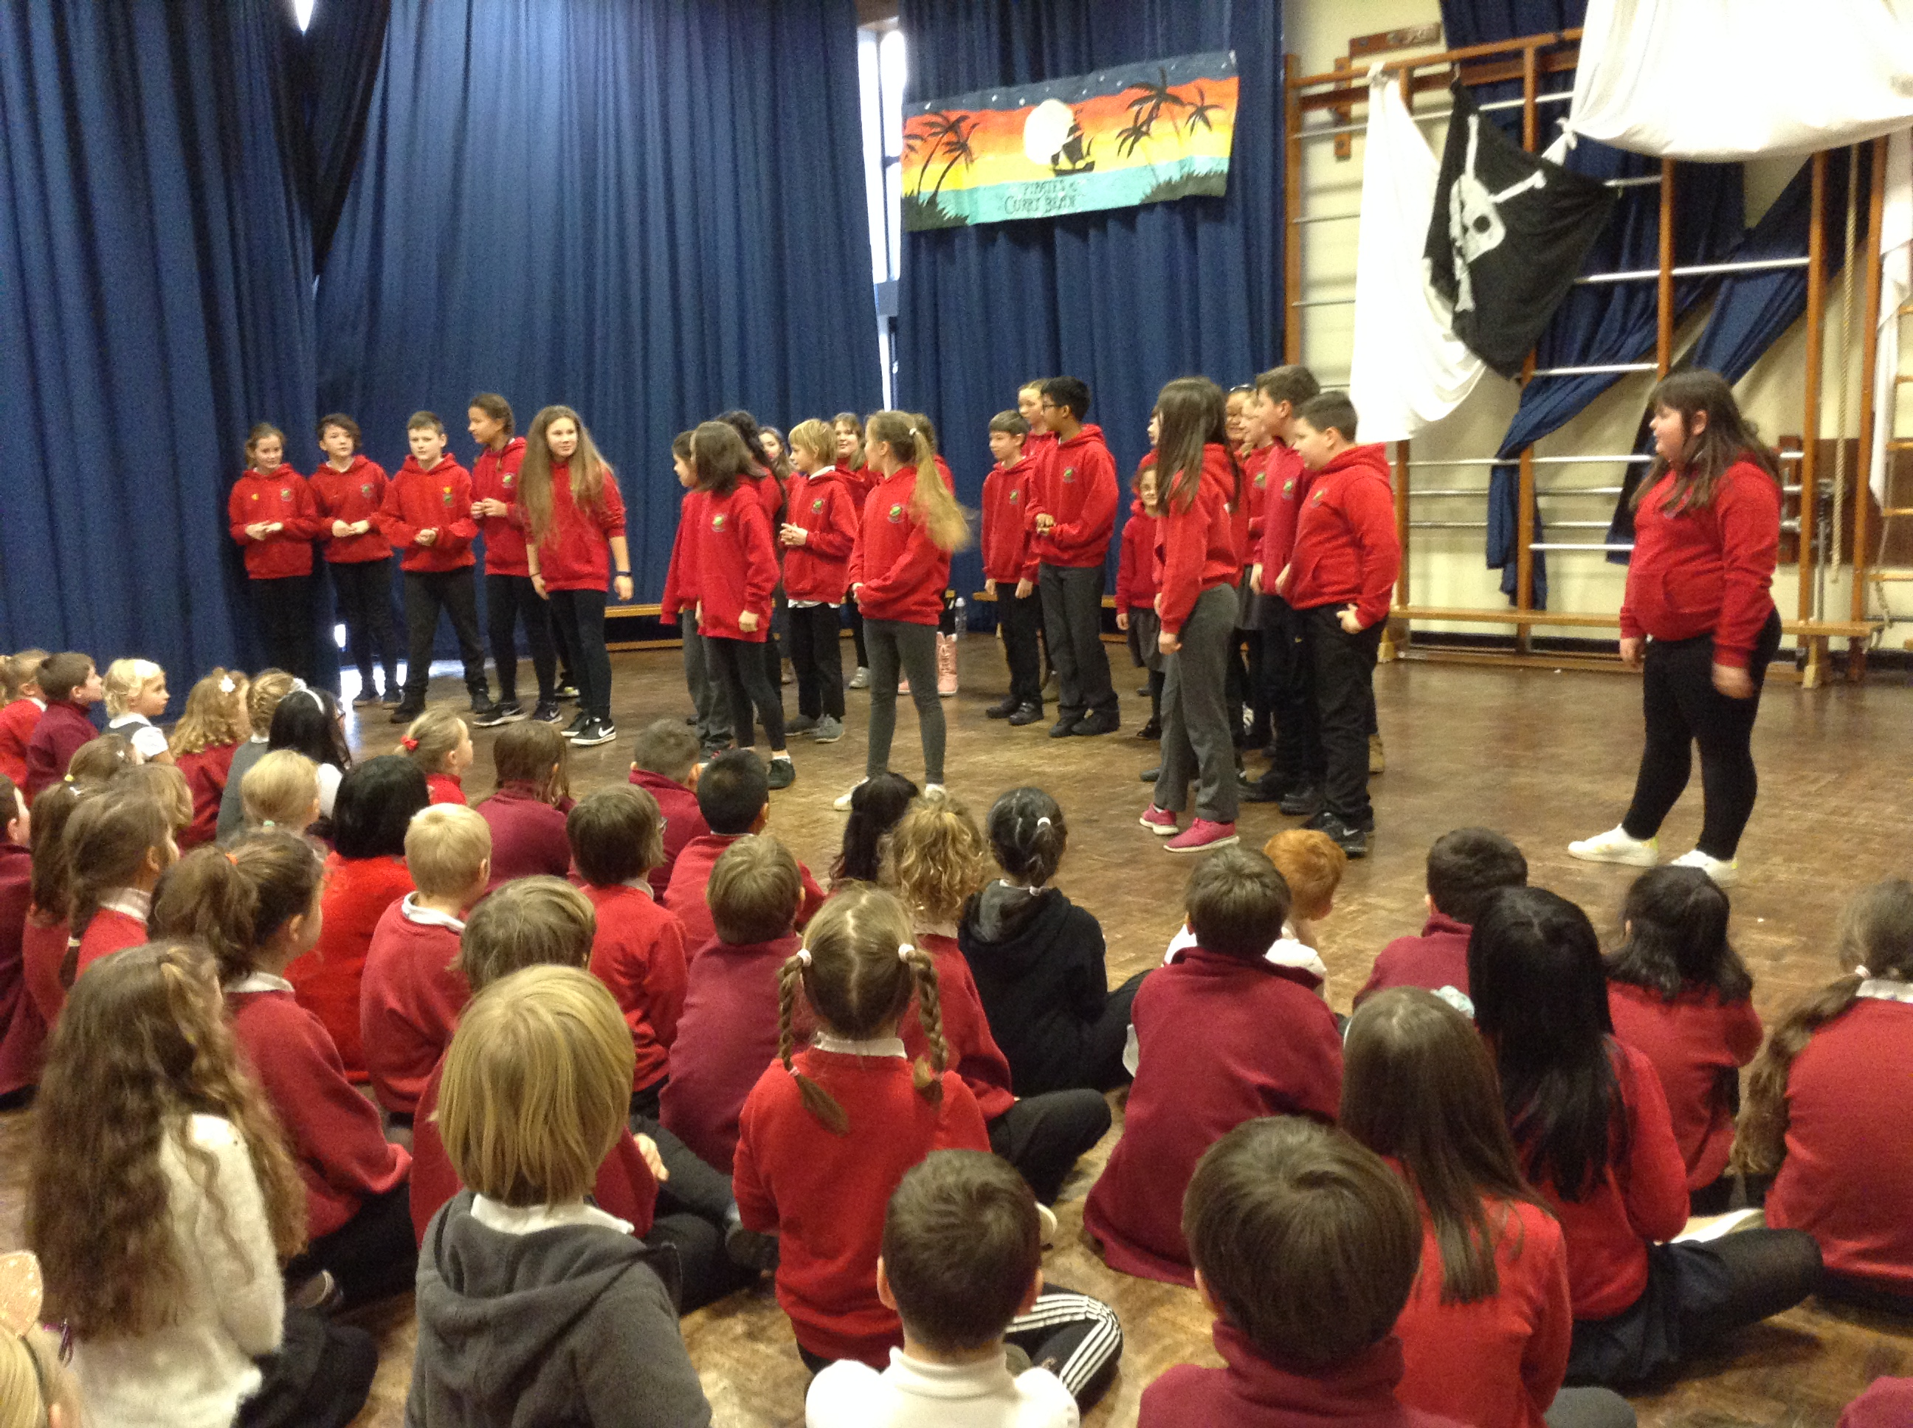
PUPIL MEETINGS AND COMMUNICATION
Organise cross-year group events for students to meet and get to know each other (and support their IB learning!)
E.G.- Mentor Schemes for Reading, Play-time Monitors, The “Buddy Scheme” for new pupils, Sports Games,
Outside Activities, Field Trips, School Music Concerts, School Plays…and think of some new ones yourself!
CONNECT the school through clear COMMUNICATION

Slide 52
ONLINE TEACHING
We need to teach online for the safety of our students in COVID-19.
We need to keep teaching EFFECTIVELY online for the education of our students.
TIPS FOR TEACHING ONLINE:
Use the Weekly Timetable Template and plan for the whole week rather than just each lesson
Include in every Weekly Online Timetable a Year Group Assembly AND a Whole School Assembly on Zoom – this is easy and excellent to do to build the community and communication of your school. Make sure the students know you are all a team!
You can also hold your staff meetings on Zoom (both yeargroup AND whole school) – keep these up and support each other when teaching online – it is difficult, so please ask for support and offer support and tips to others too!
Project work is very effective. Check, adapt and limit your activities per lesson. Don’t change your lesson objective and don’t write a new lesson plan. Just add the details in your “evaluation” box about how you made this lesson work online for your own records
Zoom is great for teaching online, but it is exhausting. Watch the amount of screen time you have every day – perhaps use up to 40mins (the Zoom maximum time-limit of 1 meeting) to introduce, discuss and model the activity, and then set independent tasks for the students to do as well

Slide 53
Online teaching TIPS!
Get your “Online Classroom” ready – do not teach in your bedroom or sitting on a couch. Sit at a desk, dress smartly, and make sure the room around you is suitable to teach from. Perhaps put up a sheet behind you to cover anything that might distract children’s learning, or consider displaying classroom posters on the wall behind you to help students focus
Make sure your students know their daily timetable. If they have a plan of the day, they will be more focused and keen to complete it with you
Make sure that your instructions and your lessons are always clear and simple
Consider meeting students in smaller groups, pairs or even 1:1 with students in online sessions for variety and differentiation
Host an online game for your class, or watch a kids cartoon together at the end of the week to let the children “relax” & “play” together – just like they would in School
Think about how you can hear the children READ online, and how you can read to them (Use Mr Tom’s lecture!)
Find the variety in your teaching – “make it fun for everyone!” ☺

Slide 54
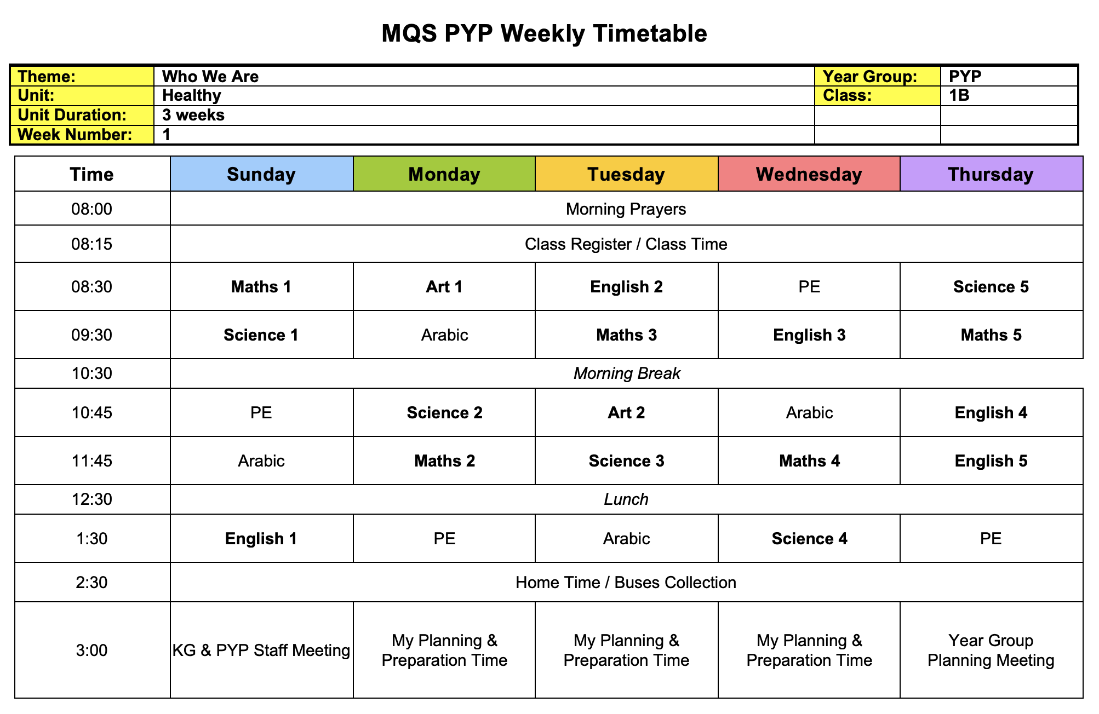
WEEKLY TIMETABLE EXAMPLE
Make sure you prepare before every week your Weekly Timetable, especially when teaching online. This will help you A LOT!!
Please feel free to change this to suit your class and school times ☺

Slide 55
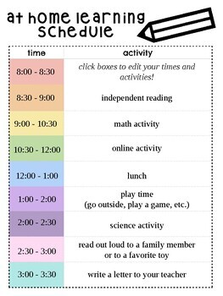
STUDENT DAILY ONLINE TIMETABLE EXAMPLE
Please feel free to change this to suit your class and school times ☺

Slide 56
HELPFUL INFORMATION / Resources
It’s important as teachers that we realise that we should keep a lot of things safe and handy!! The most important being:
ALL of our Planning
ALL of our Records
Any resources we use / will use again in the future
To help you build your Library, I have made each year a folder of suitable and interesting Resources that you are welcome to use, which includes all of the templates to make your Private Teacher File and Student Records
Please keep looking and building your “Teacher’s Cupboard” of resources for your classroom – they do not have to been expensive to be wonderful and creative. Something so simple can enhance your teaching and capture the students’ imagination in an instance… inspiring them to learn!
For example, “scrunch” up a piece of paper = this can be used as a football at home (for online learning) or as clouds on the poster wall display in your School classroom
If you need any support finding more resources, or you are having trouble finding a suitable one for your students, then please contact me and I can send some options and ideas on email to you ☺

Slide 57
MENTORS
The support that you have received from this MQS Summer School will continue
We want to keep advising, helping and supporting you as you make MQS the best school in Iraq!
We are SO proud of all the work you have done so far, and it has proved that you ARE ready to do these next steps
PLEASE listen and accept what we have said and enhance your own development as a professional teacher by completing this work
…..so work together! ☺☺☺☺☺☺☺☺

Slide 58
Next TEN TEACHER steps: WHAT YOU MUST DO NOW
Keep writing your individual Lesson Plans and building your Library of Lesson Plans. Every teacher needs to have a lesson plan for every lesson they teach. Remember you do not have finish the whole School Year before you start in September! Build this Library up throughout the School Year - but always aim to have 1 Unit completed before you start teaching it (that way you stay in front and in control ☺)
Save these Lesson Plans on Managebac and your Private Teacher File on your own computer
Make sure you prepare your Class Records before the School Year begins so you are organised and ready to go! ☺ These include your: Class Name List, Individual Student Reading Logs, Student Mark Books, Student Yearly Progress Records, Seating Plan (which can be changed), etc.
Enjoy building your Private Teacher File over the School year and save helpful Resources, Worksheets, Videos and useful tips!
Arrange a time for your Weekly Staff Meetings to keep communication positive and prosperous: Year Group & Whole School. If you can, make your 1st Staff Meeting just before Term begins – so you can all “check” that everything is ready to go!
Arrange a time for your Weekly Assembly with Staff & Students: Year Group & Whole School
Start your Whole School Rewards “School Star of the Week” system and make sure everyone is clear what the Whole School Sanctions are (maybe confirm these in your next Whole School Staff Meeting)
Organise your Mentor Meeting to discuss your progress and keep moving forward! ☺
If you are teaching online, make sure you get your “Online Classroom” sorted and know how to work everything clearly and efficiently
Get ready to welcome your students and support their big step as the move into your classroom…I know you will all have a GREAT year together! ☺ ☺

Slide 59
SOME FINAL THOUGHTS…

Slide 60
THANK YOU FOR YOUR TIME AND your TEACHING
If you have any questions, or would like support in your teaching,
please email me anytime ☺
JOANNA MARIE SKILLETT
JOANNAMARIESKILLETT@GMAIL.COM

